Slide 1
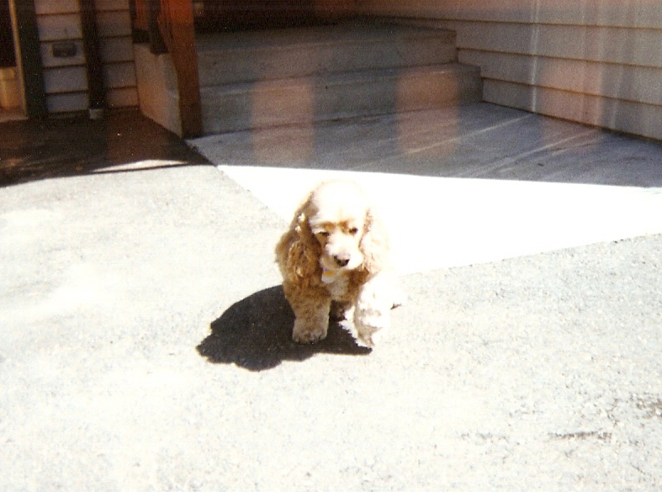

Remembering Scoober
Spring 1999 – The Newest Murphy

Slide 2
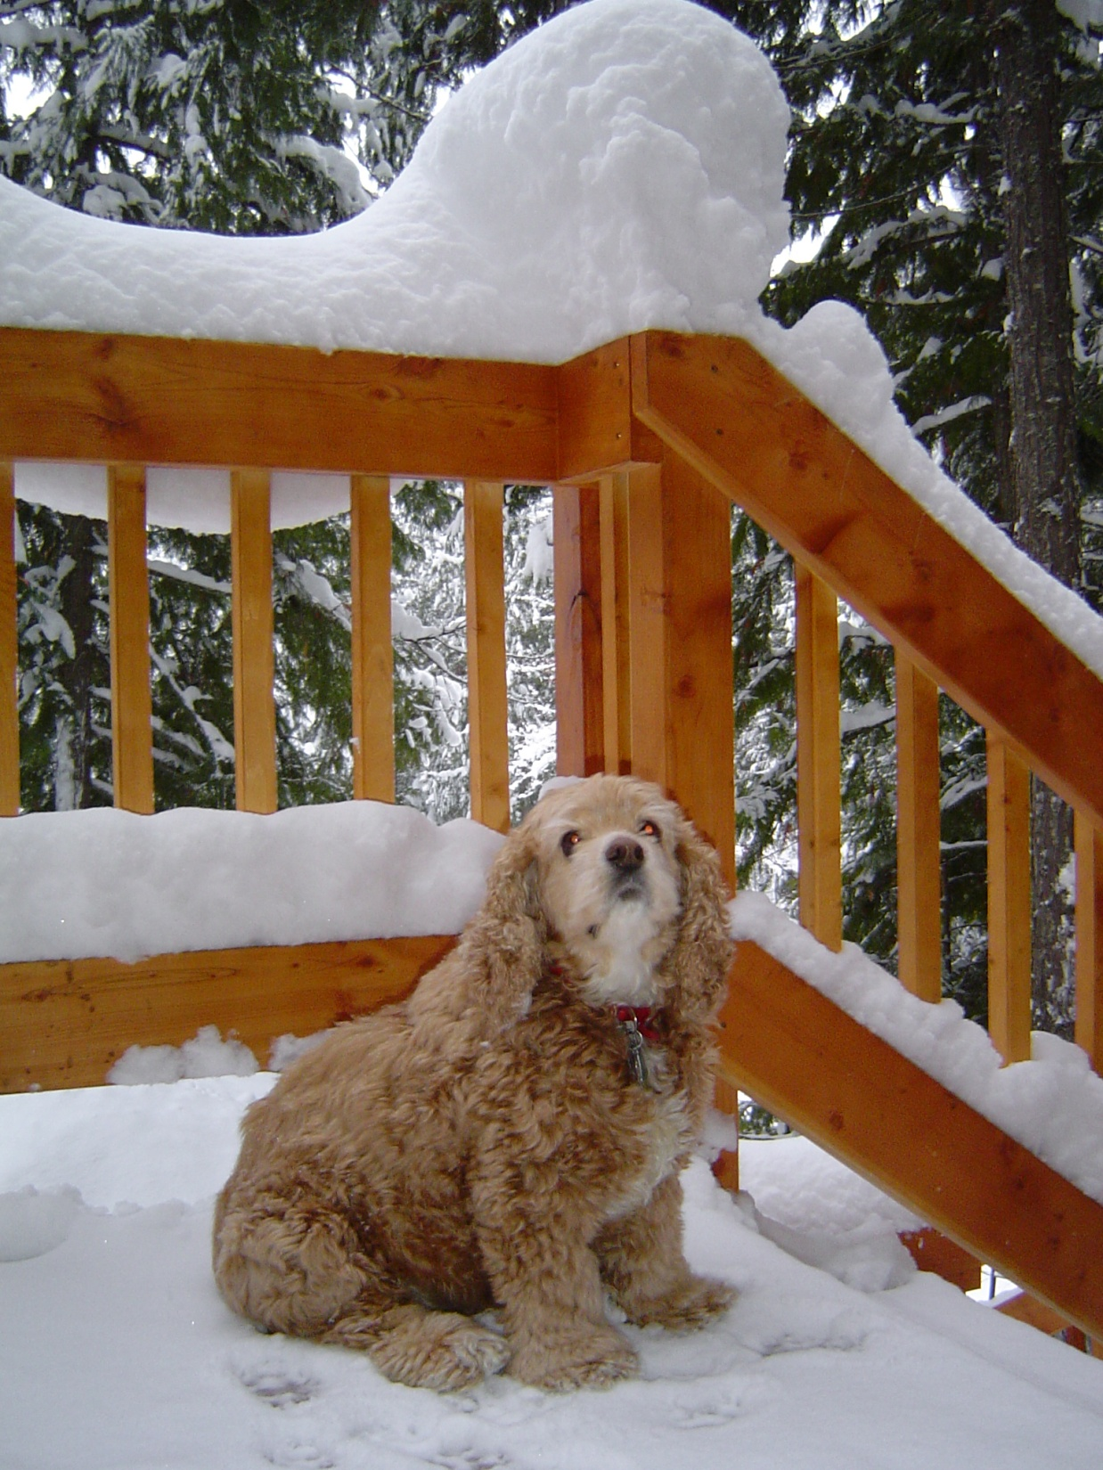

Slide 3
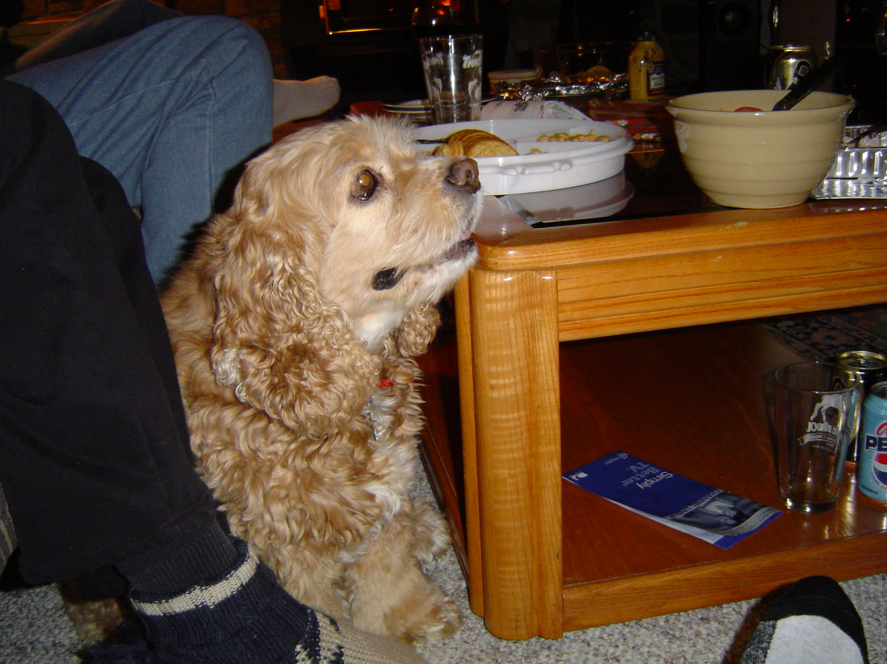

Slide 4
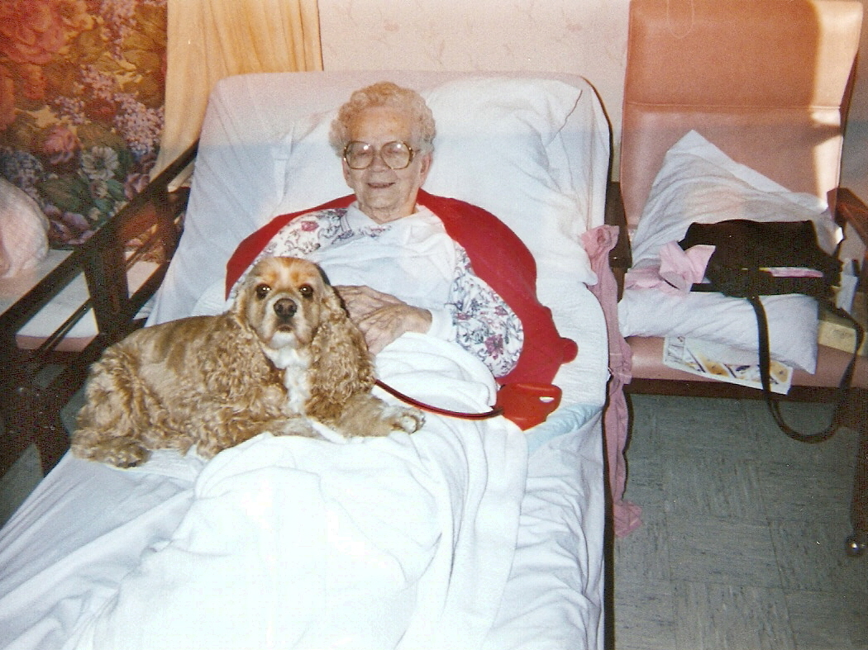

Slide 5
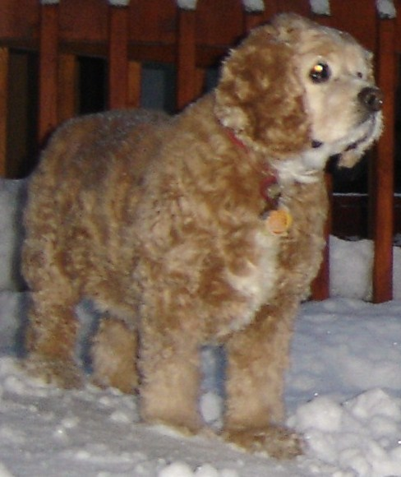

Slide 6
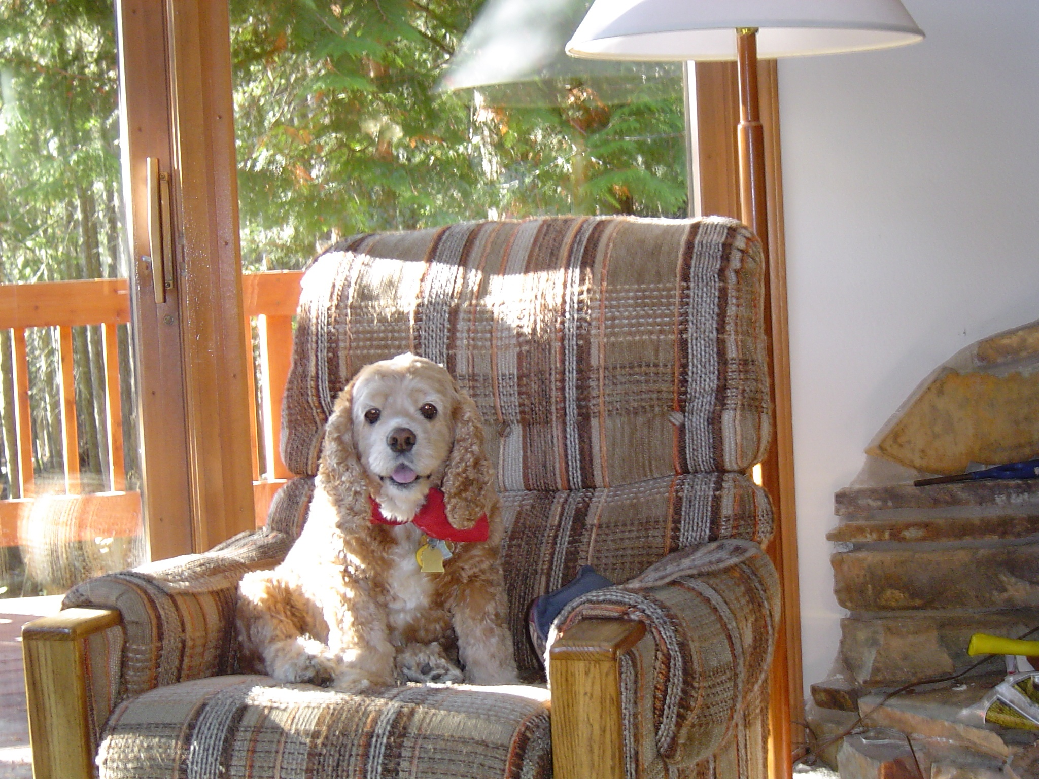
Always with a smile on her face

Slide 7
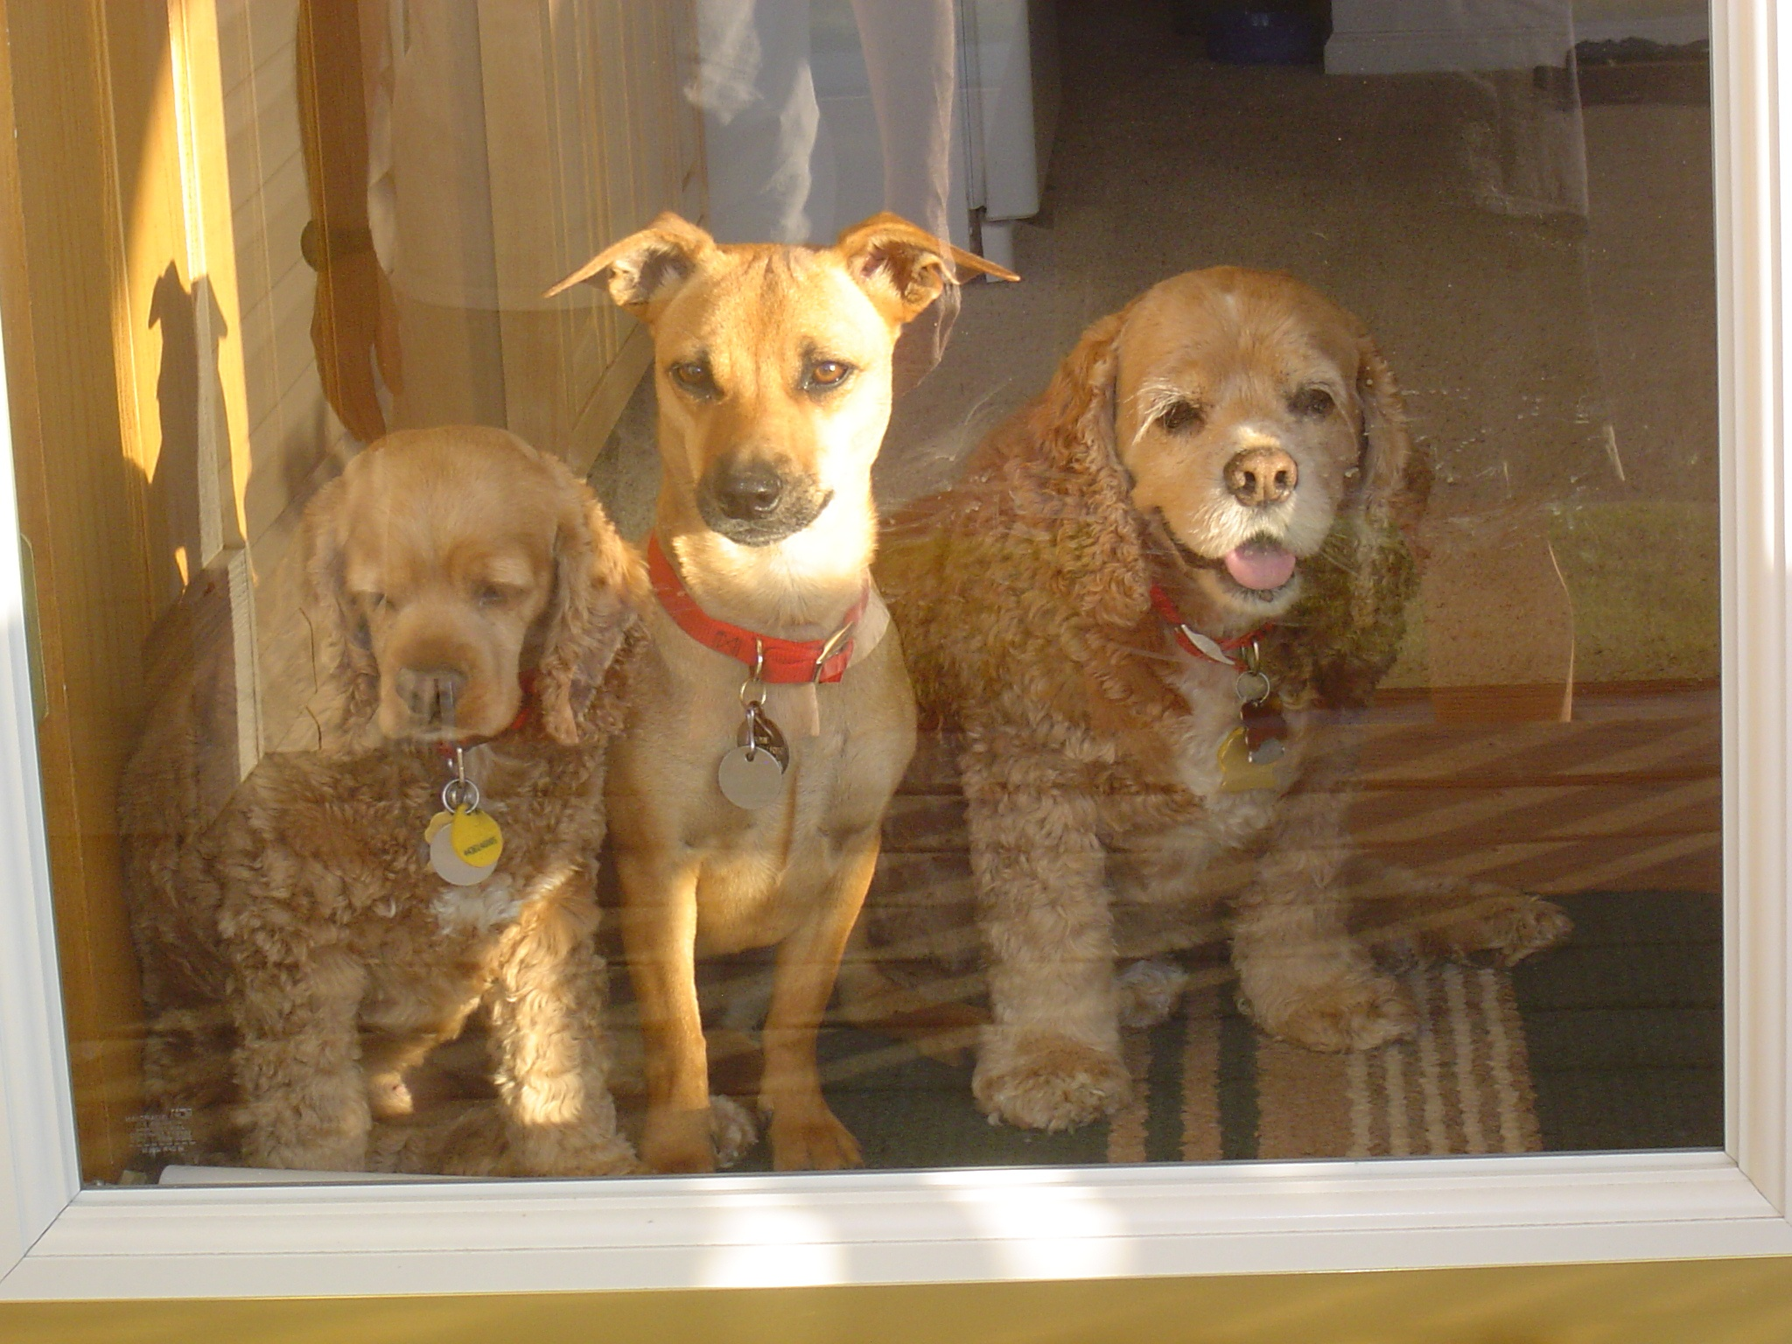

Slide 8
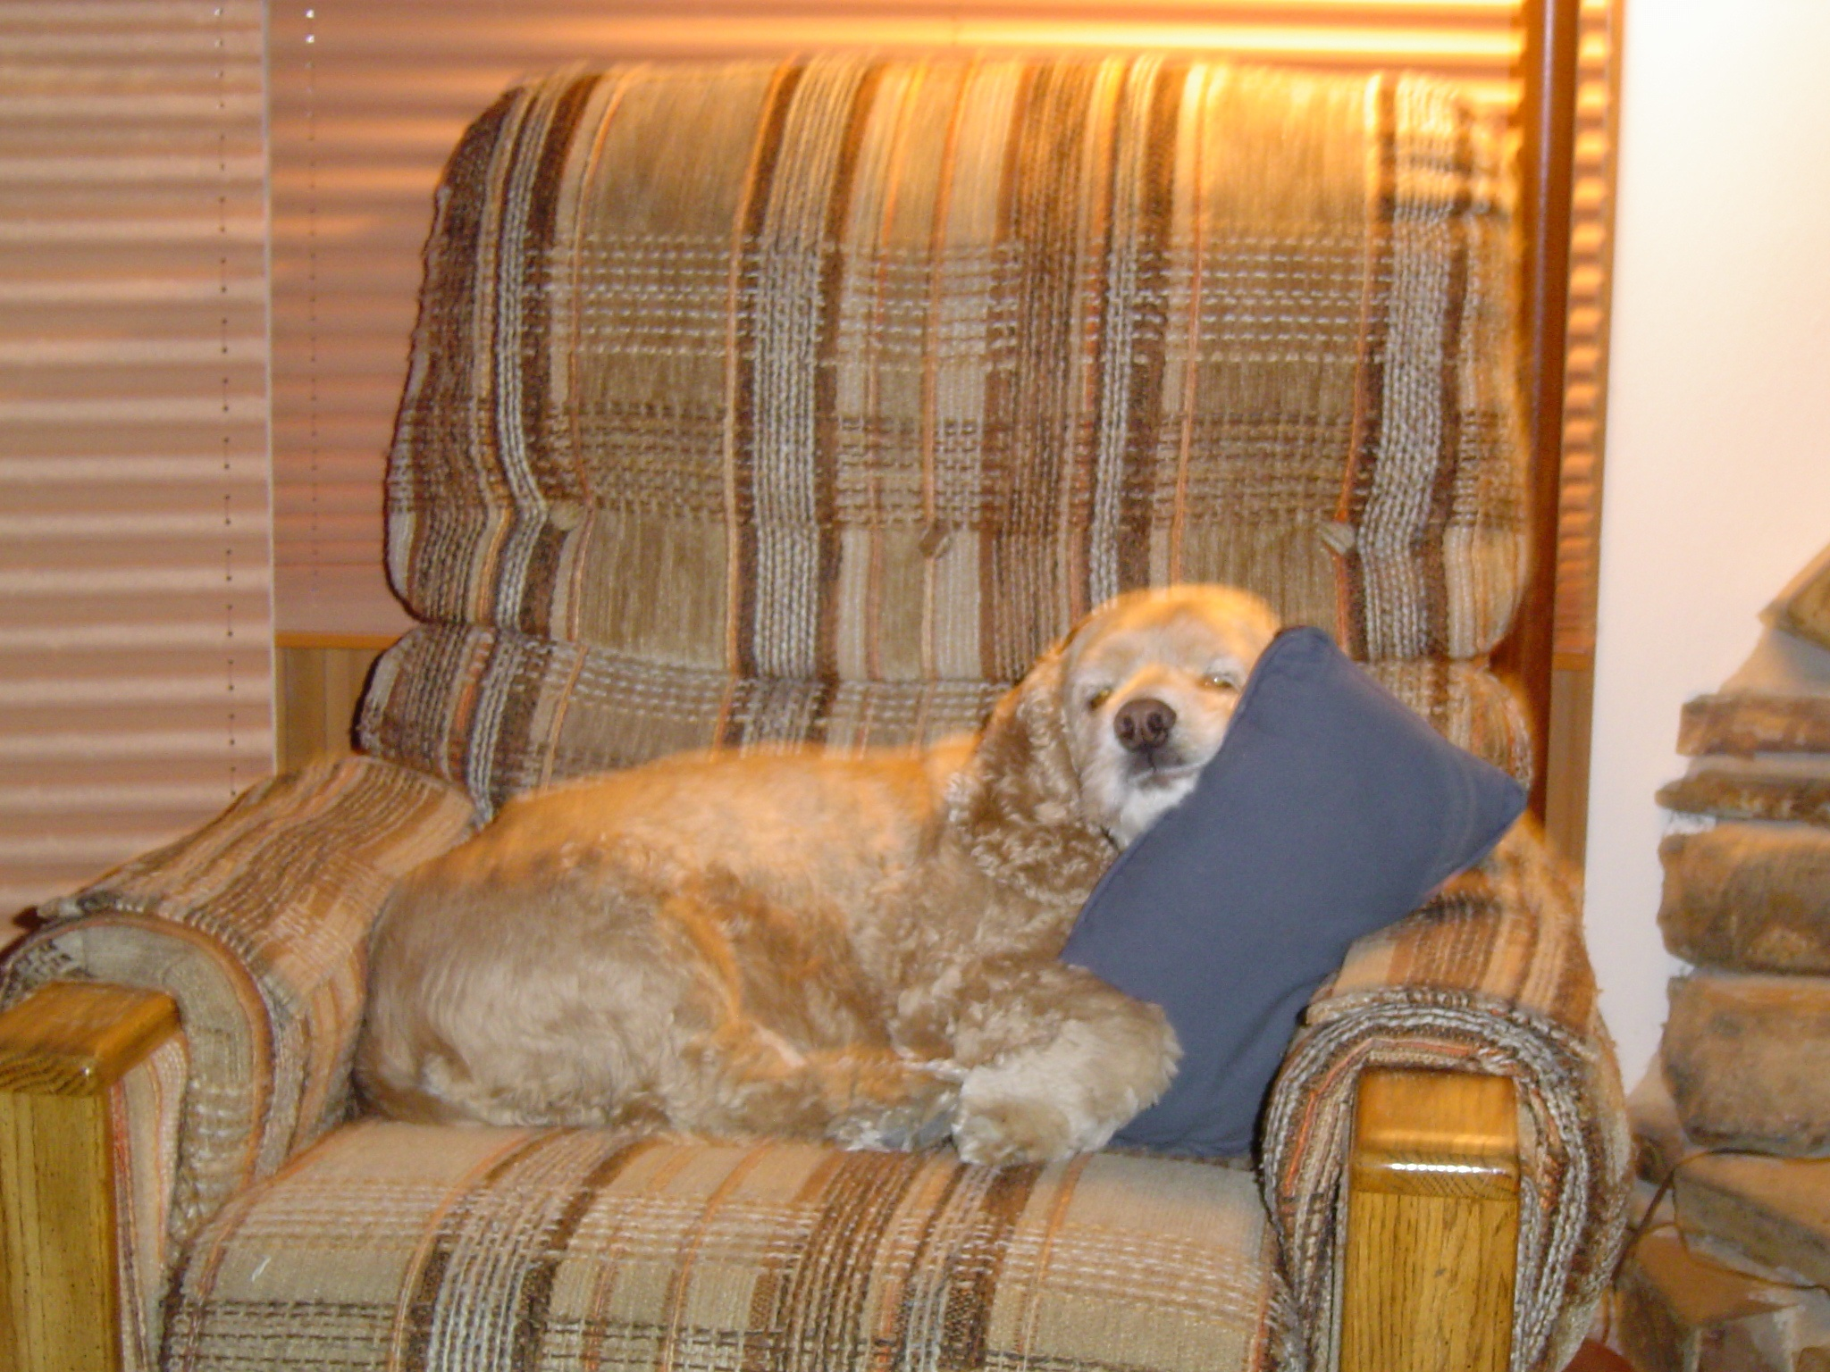
Only the pure of heart sleep like this

Slide 9
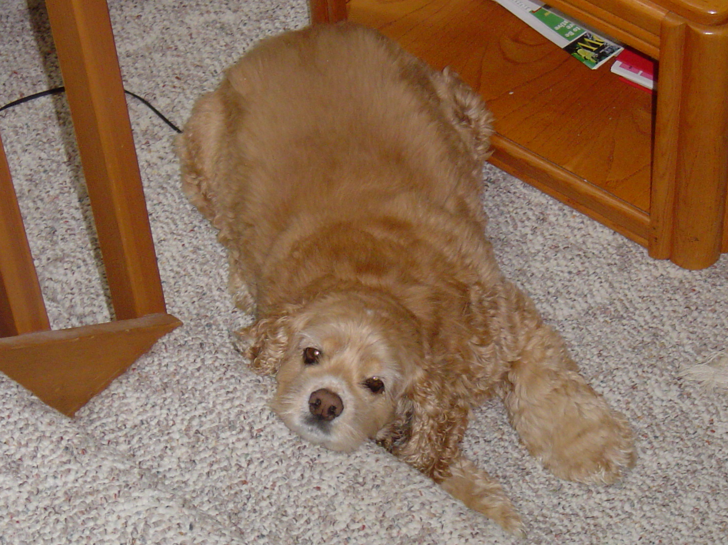
Scoober Screensaver

Slide 10
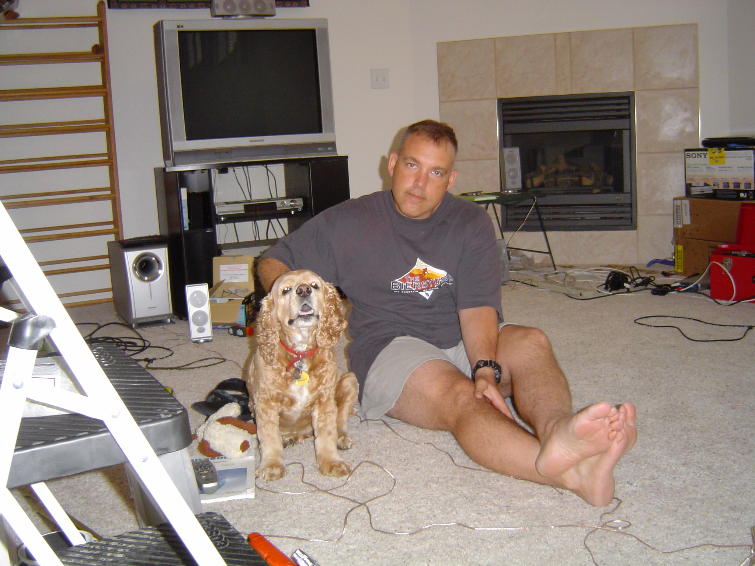
Uncle Jay’s back from Korea – Summer 2004

Slide 11
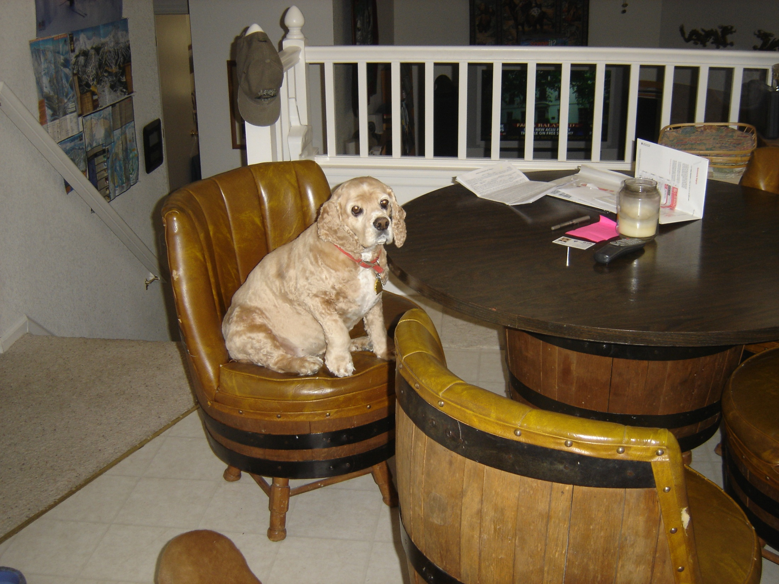
“Where is my chow?” – Summer 2004

Slide 12
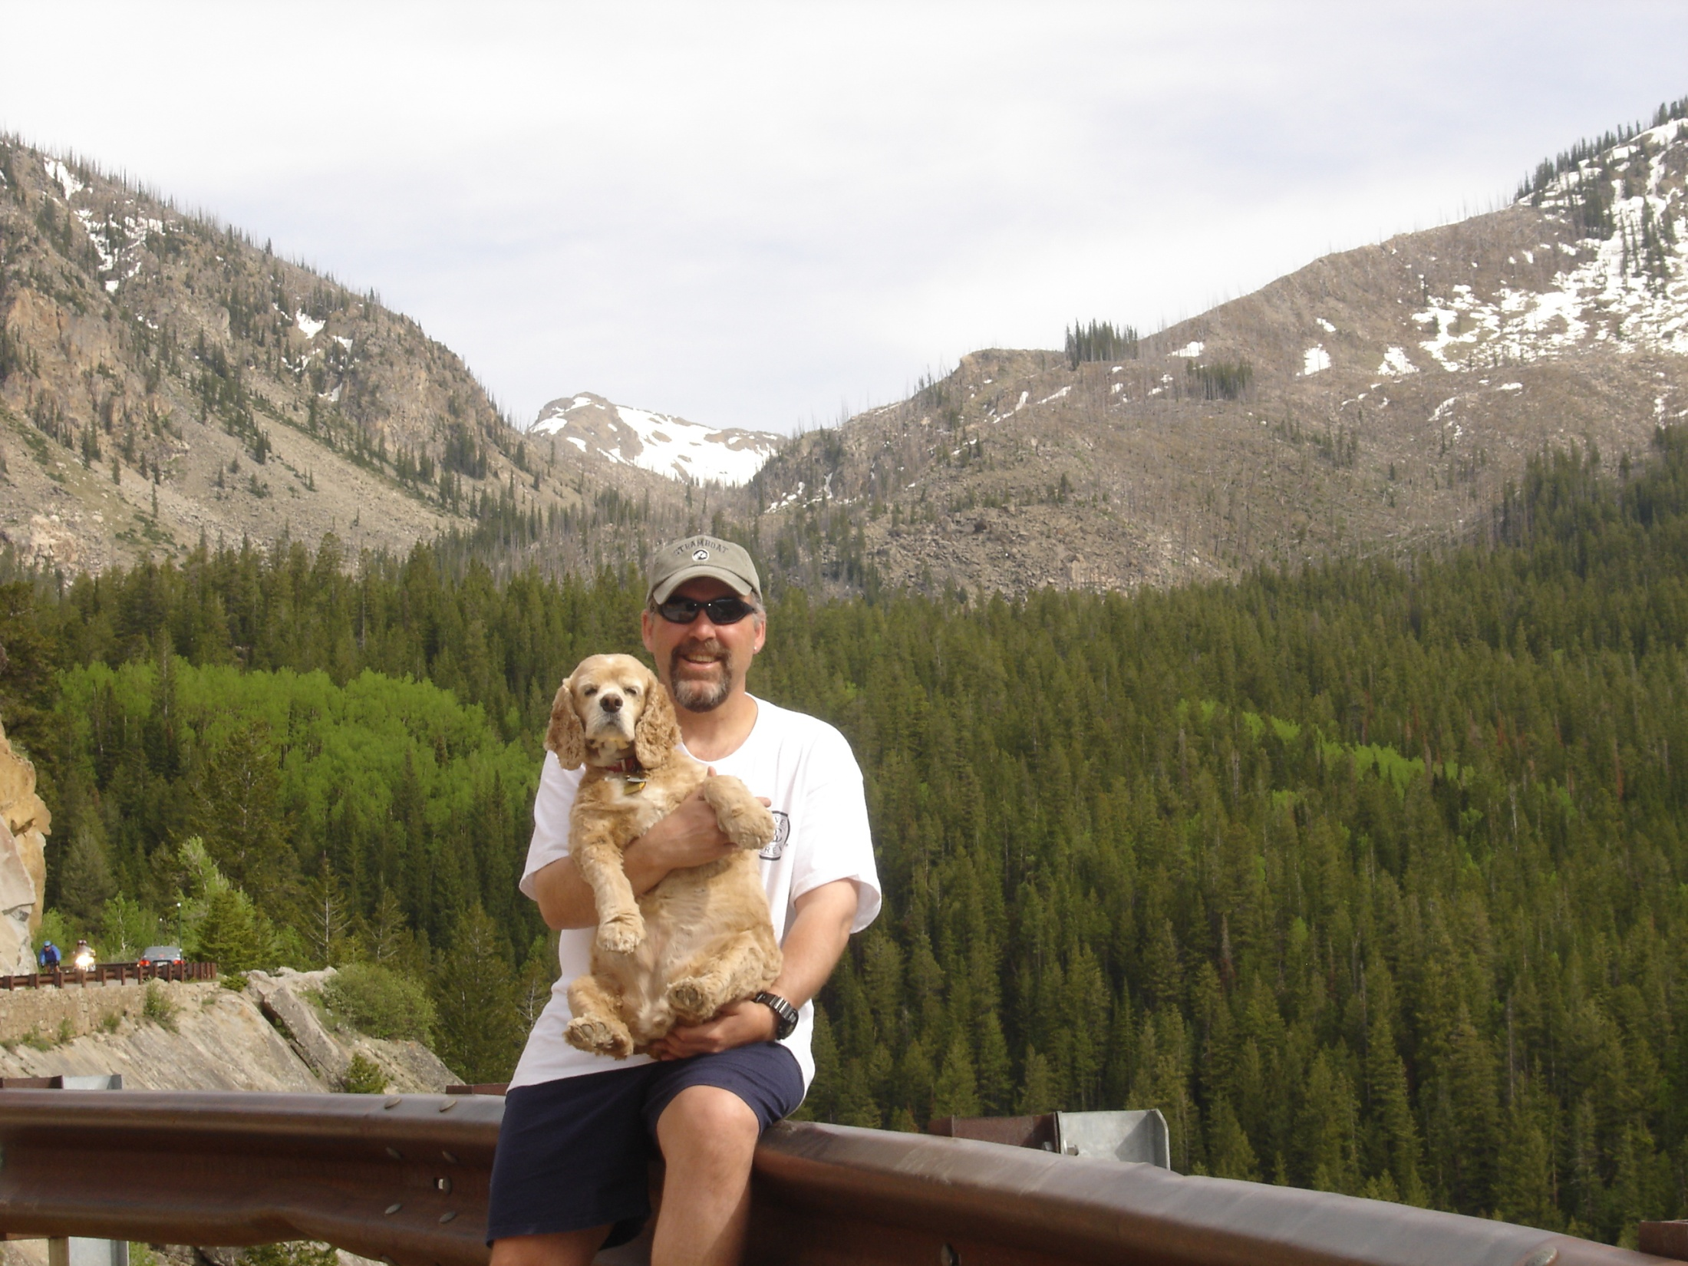
Summer 2006 – near Aspen, CO

Slide 13
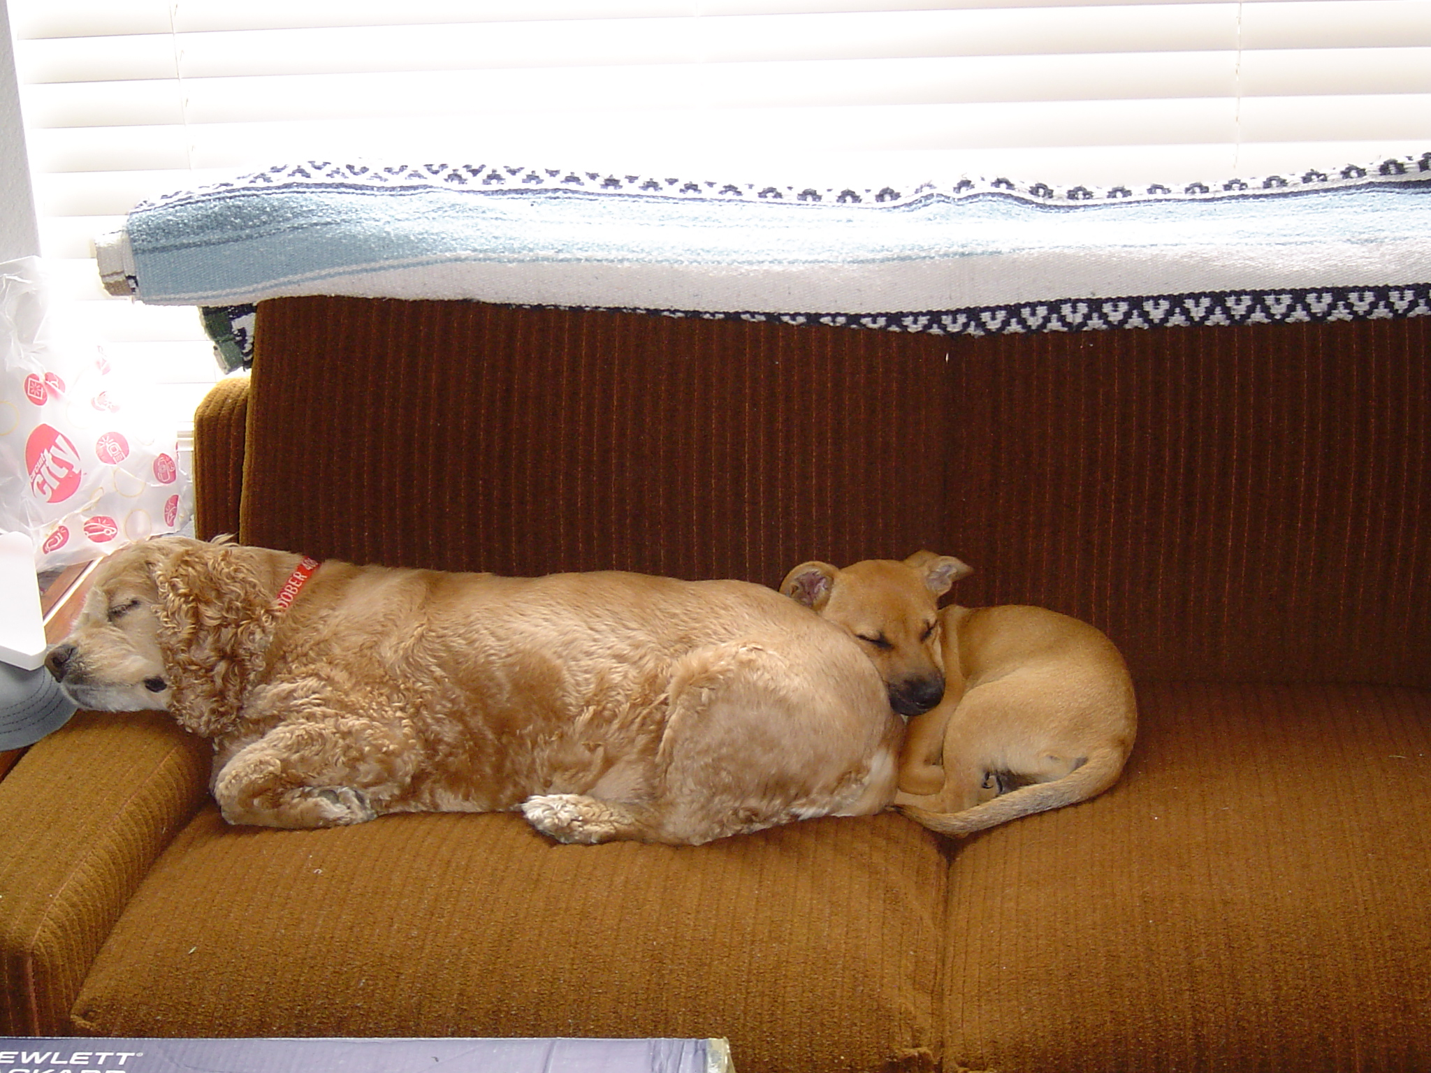

Slide 14
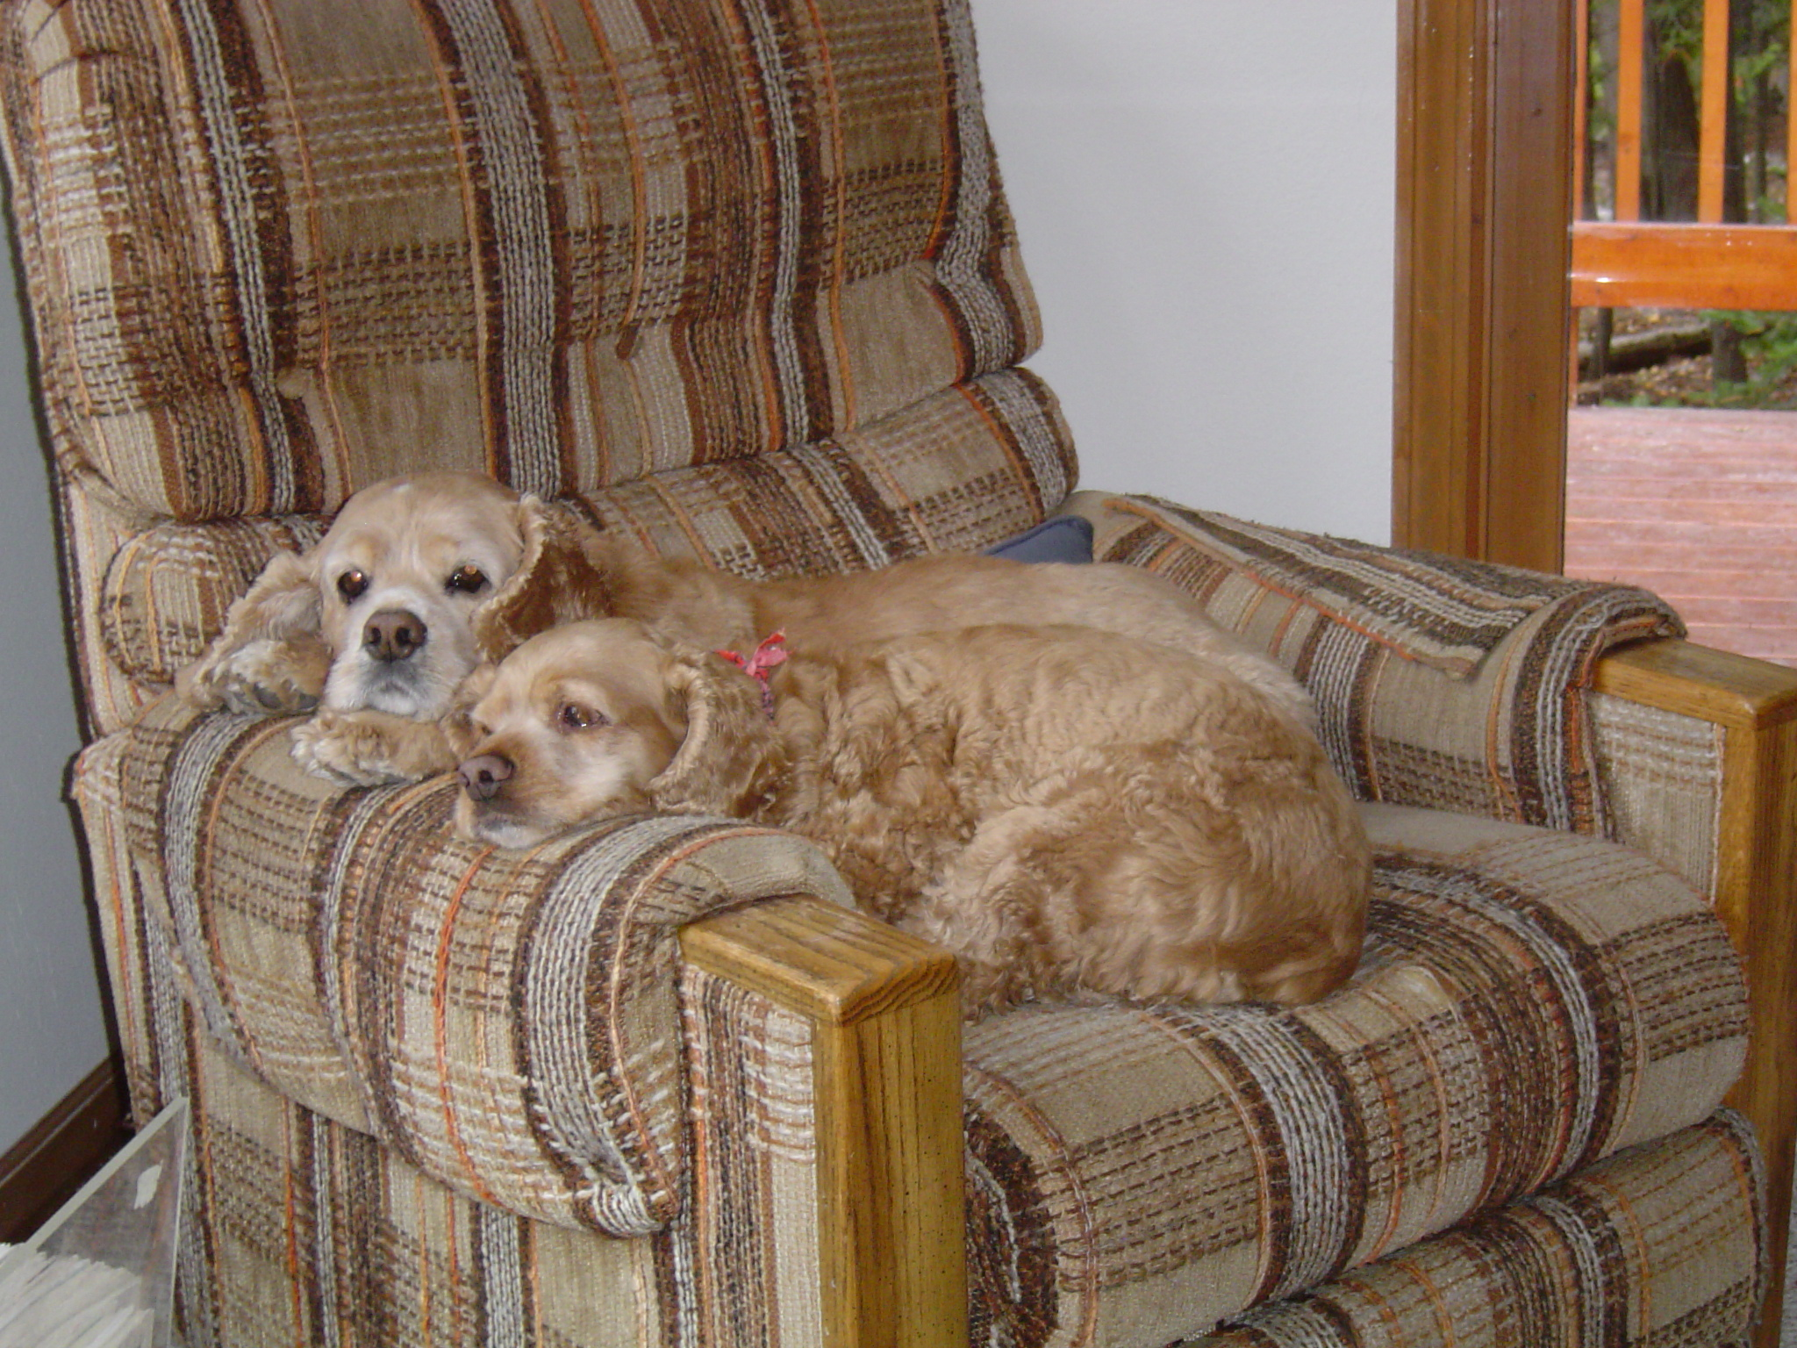
“I’ll share my spot with Lady”

Slide 15
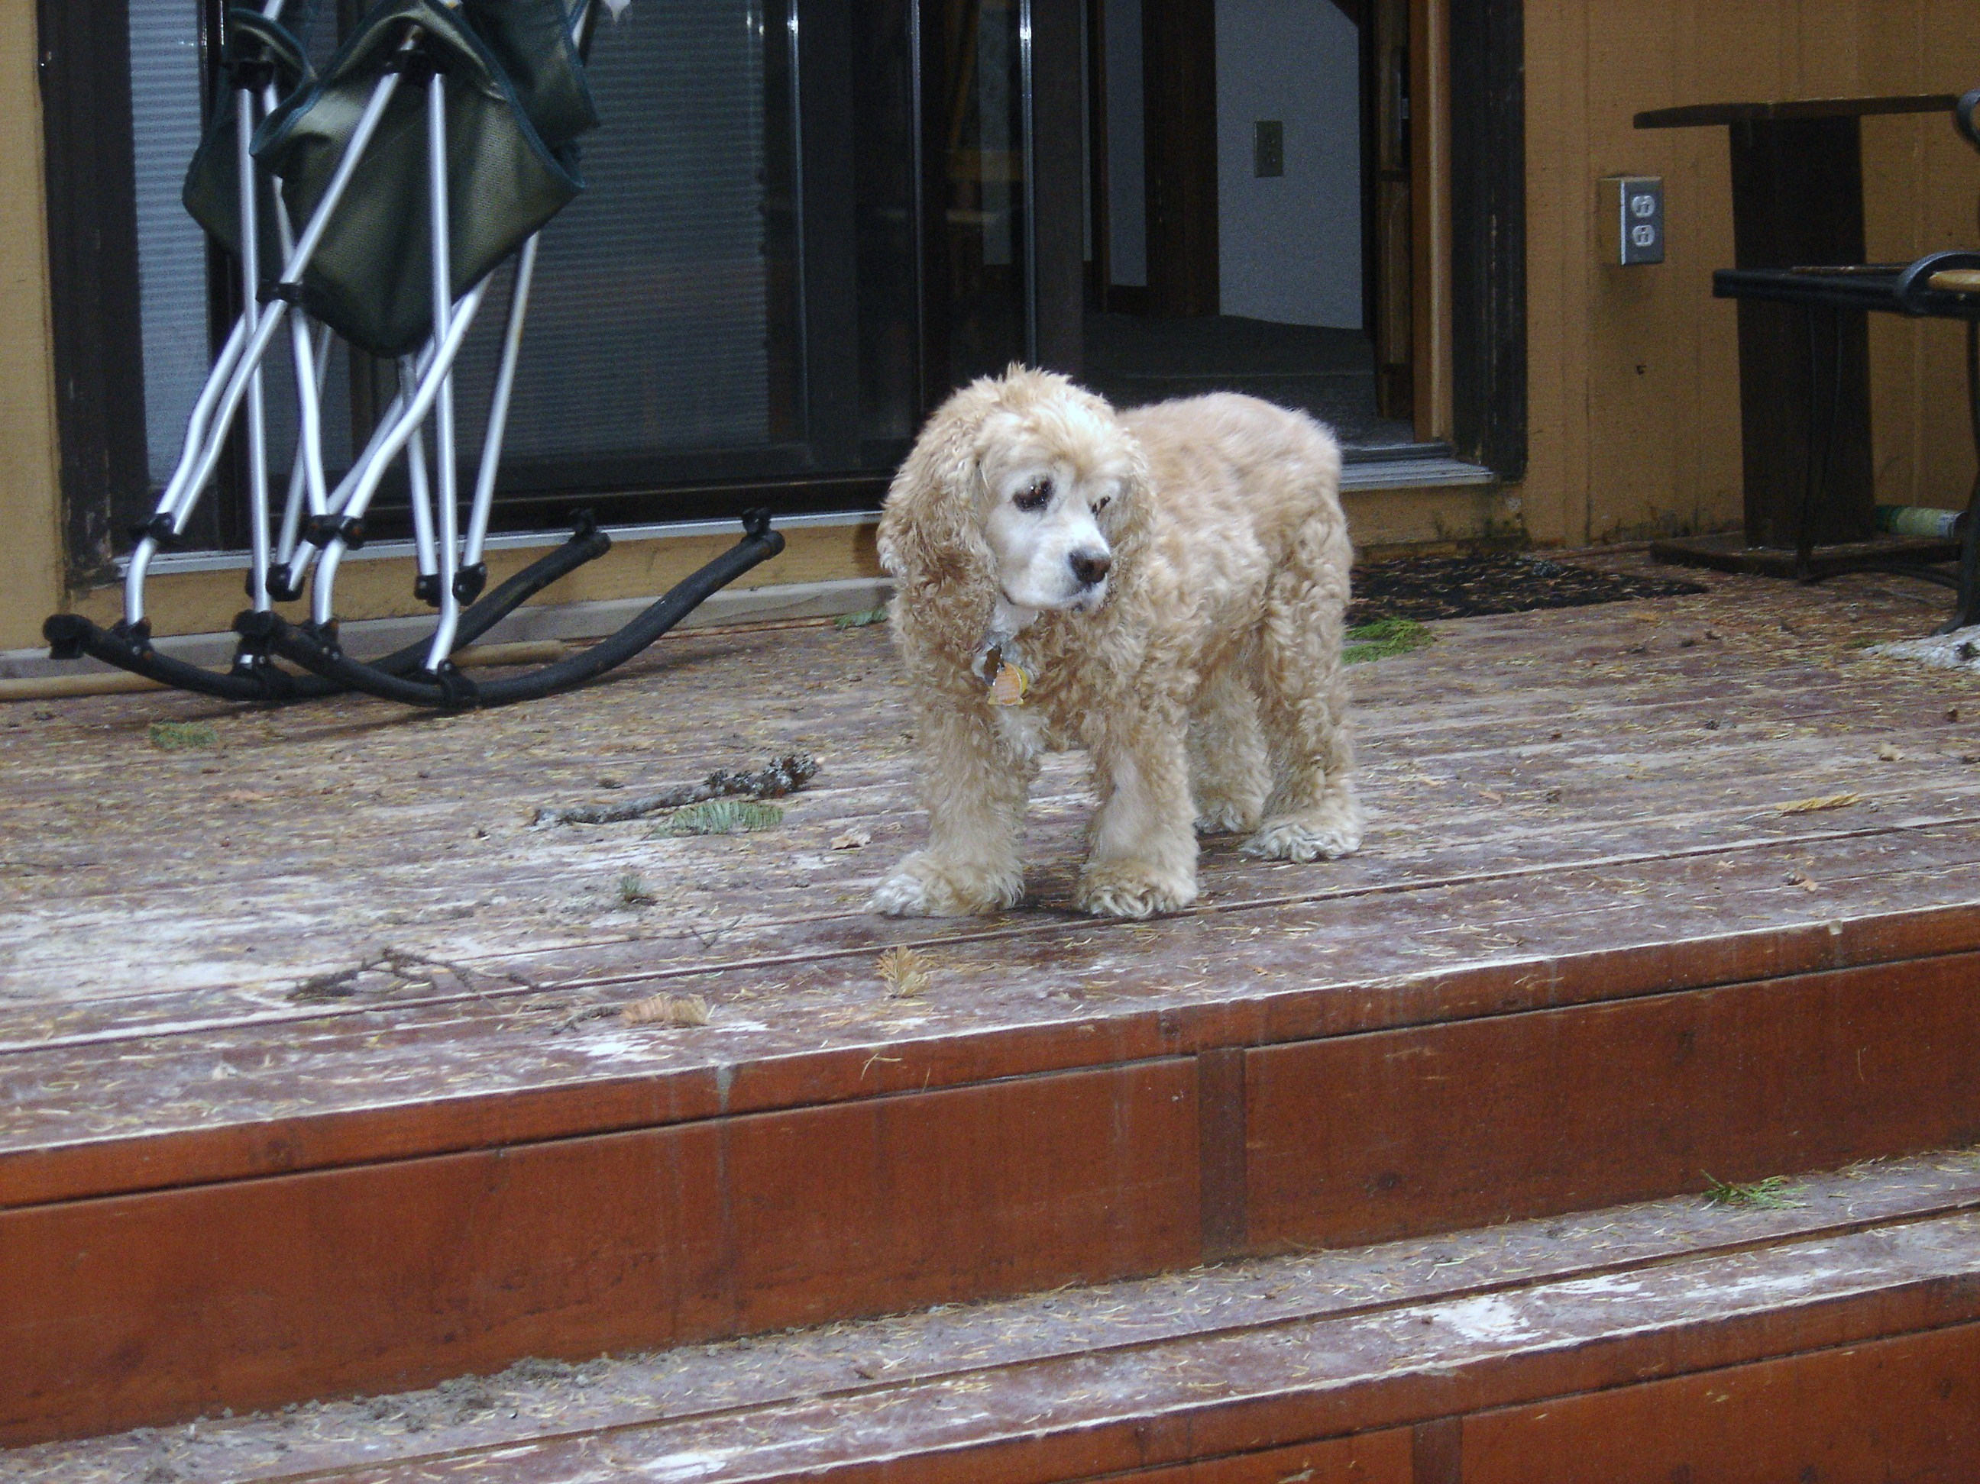

Slide 16
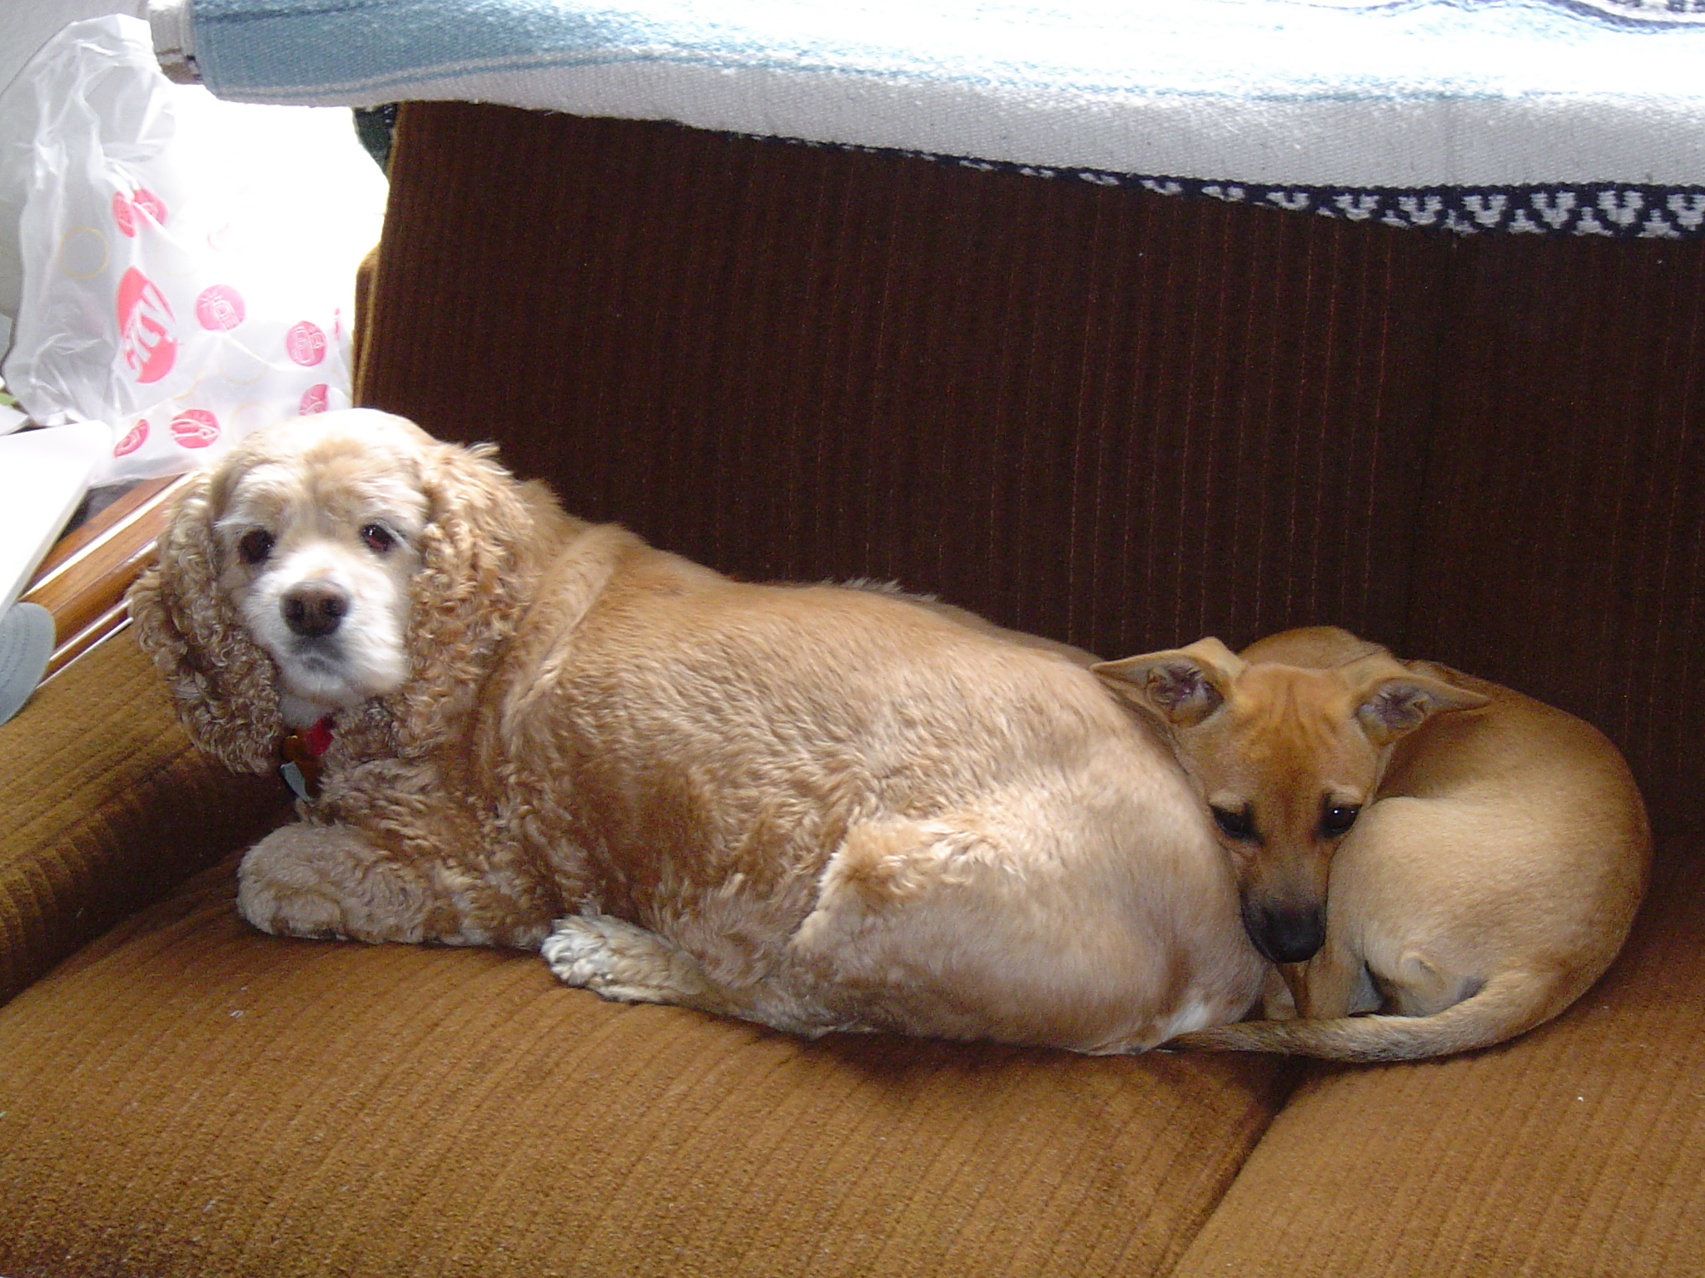

Slide 17
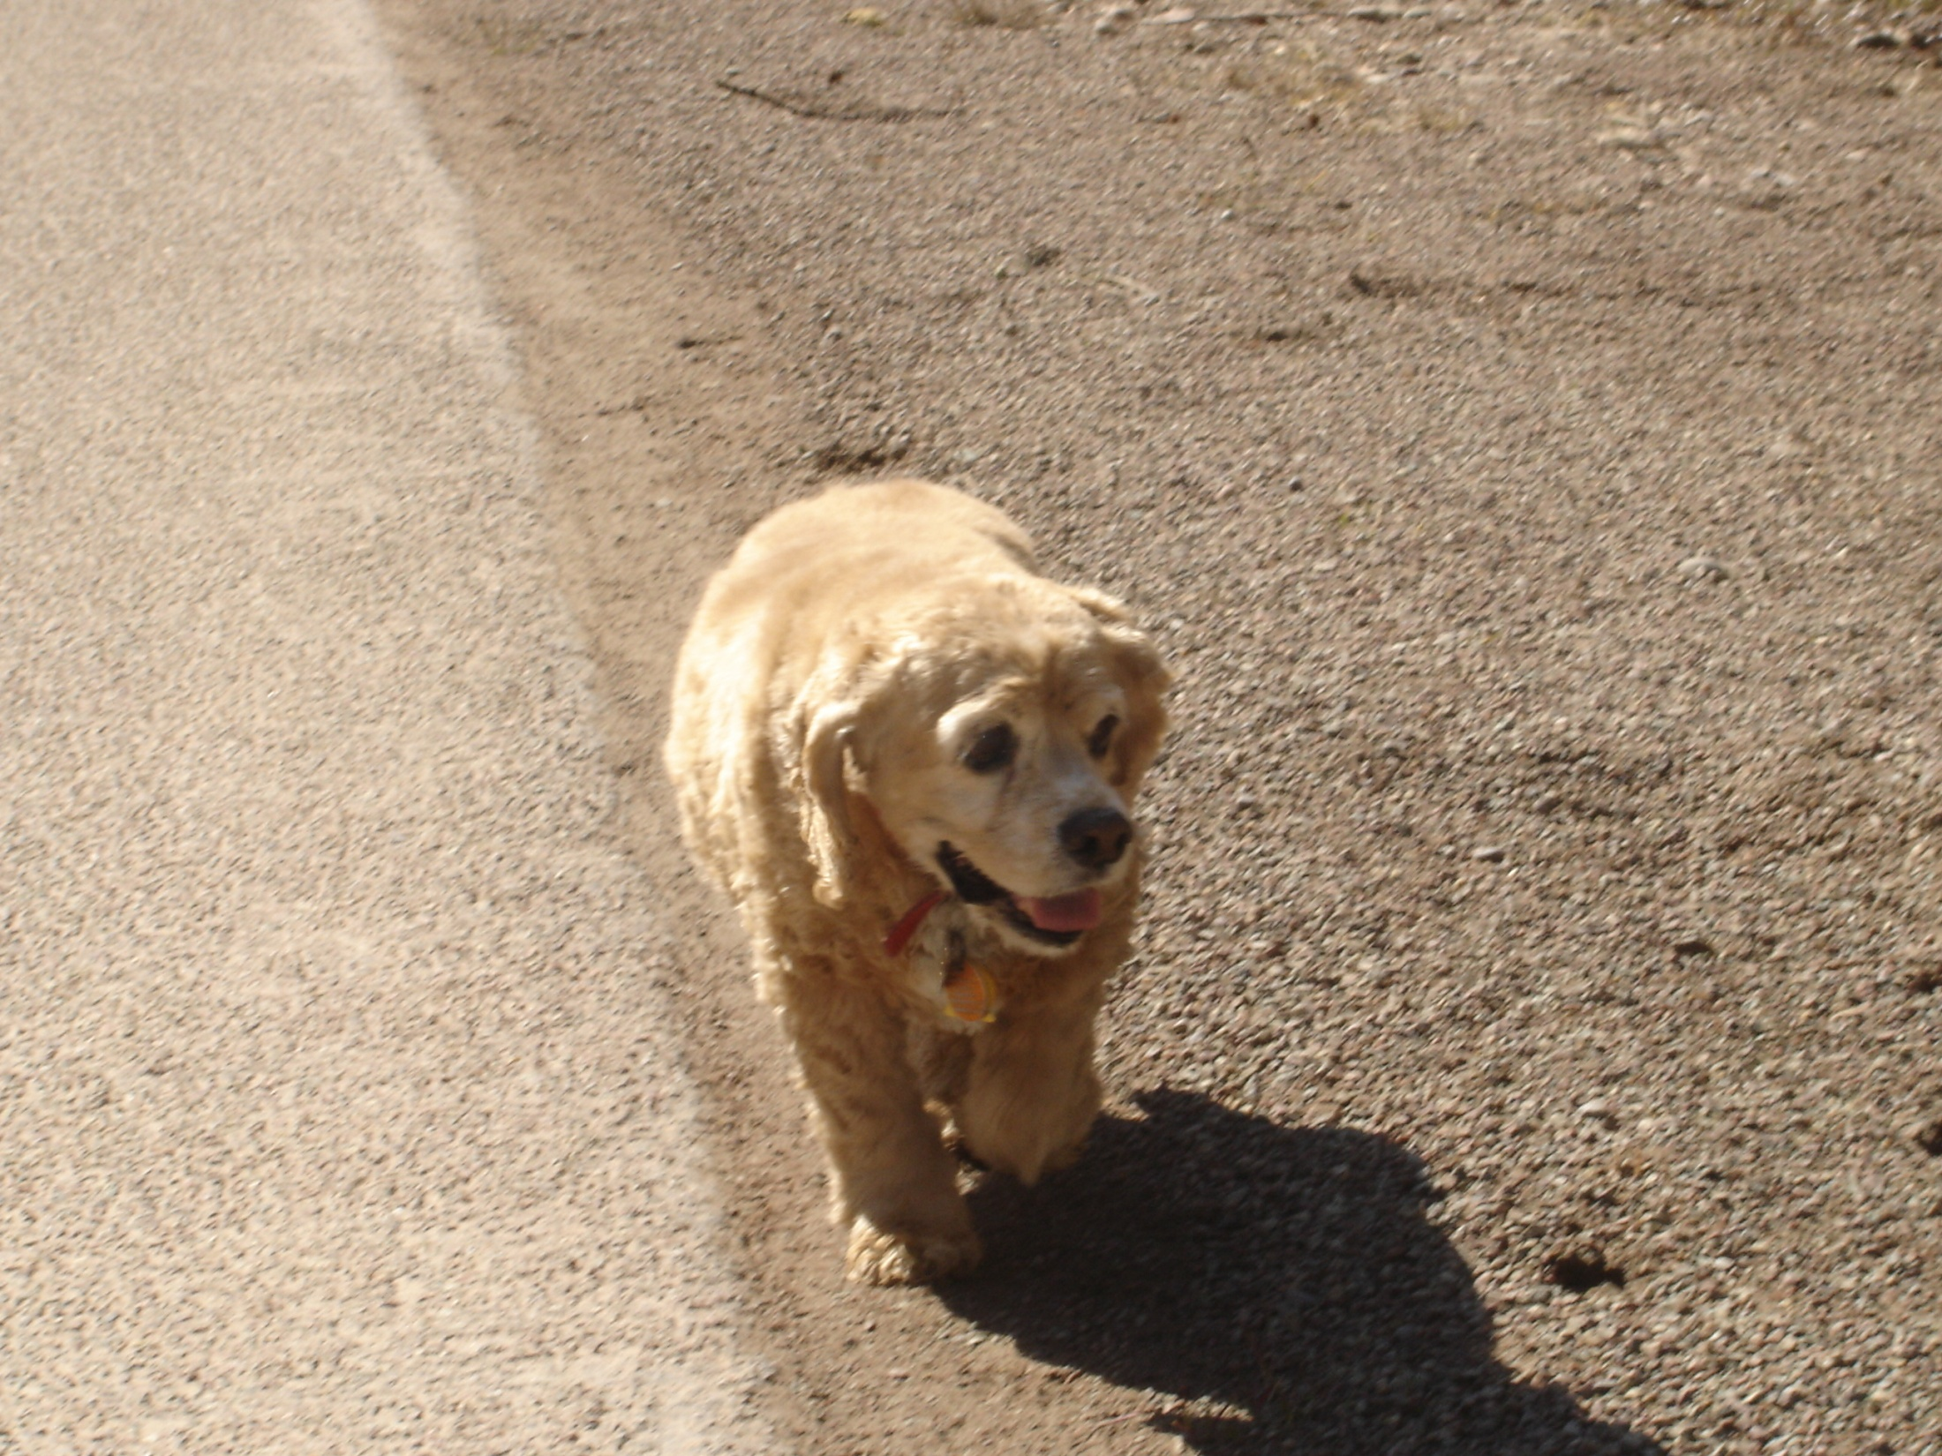
Scoober – Ambassador for Ptarmigan Village

Slide 18
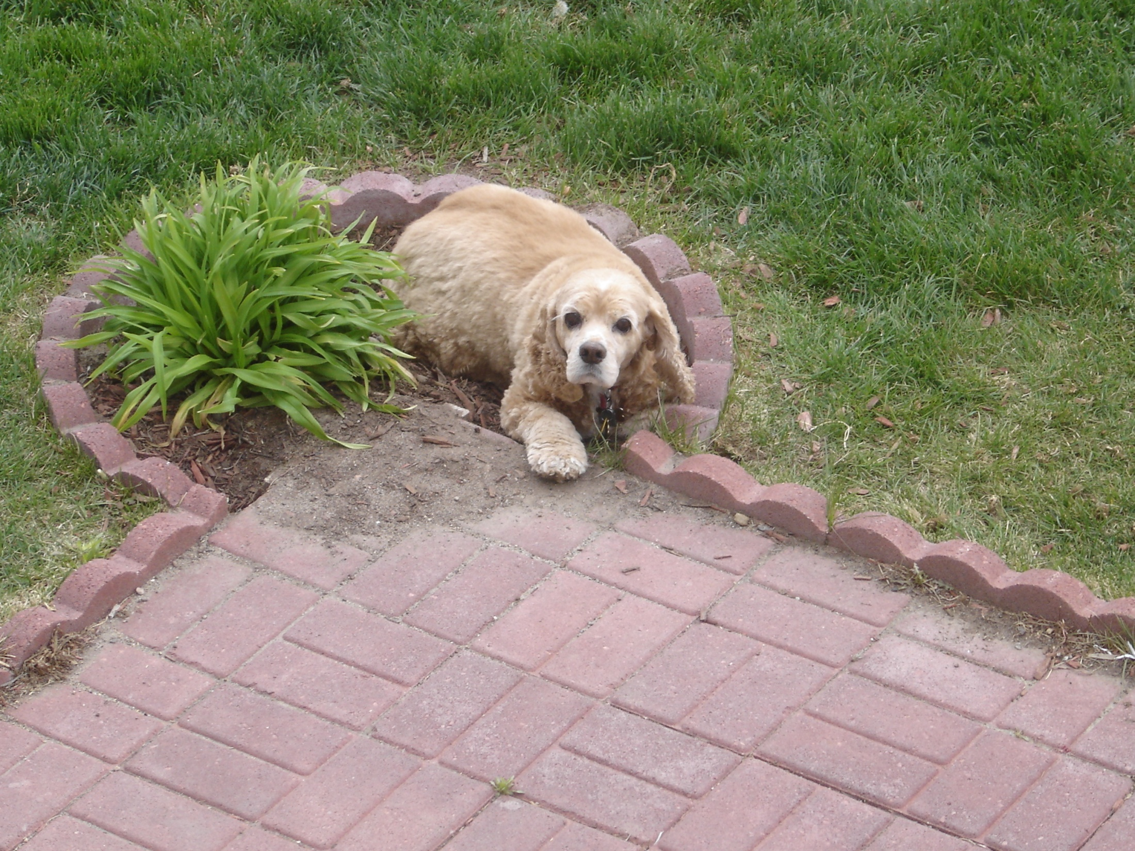
Cool Spot 2006

Slide 19
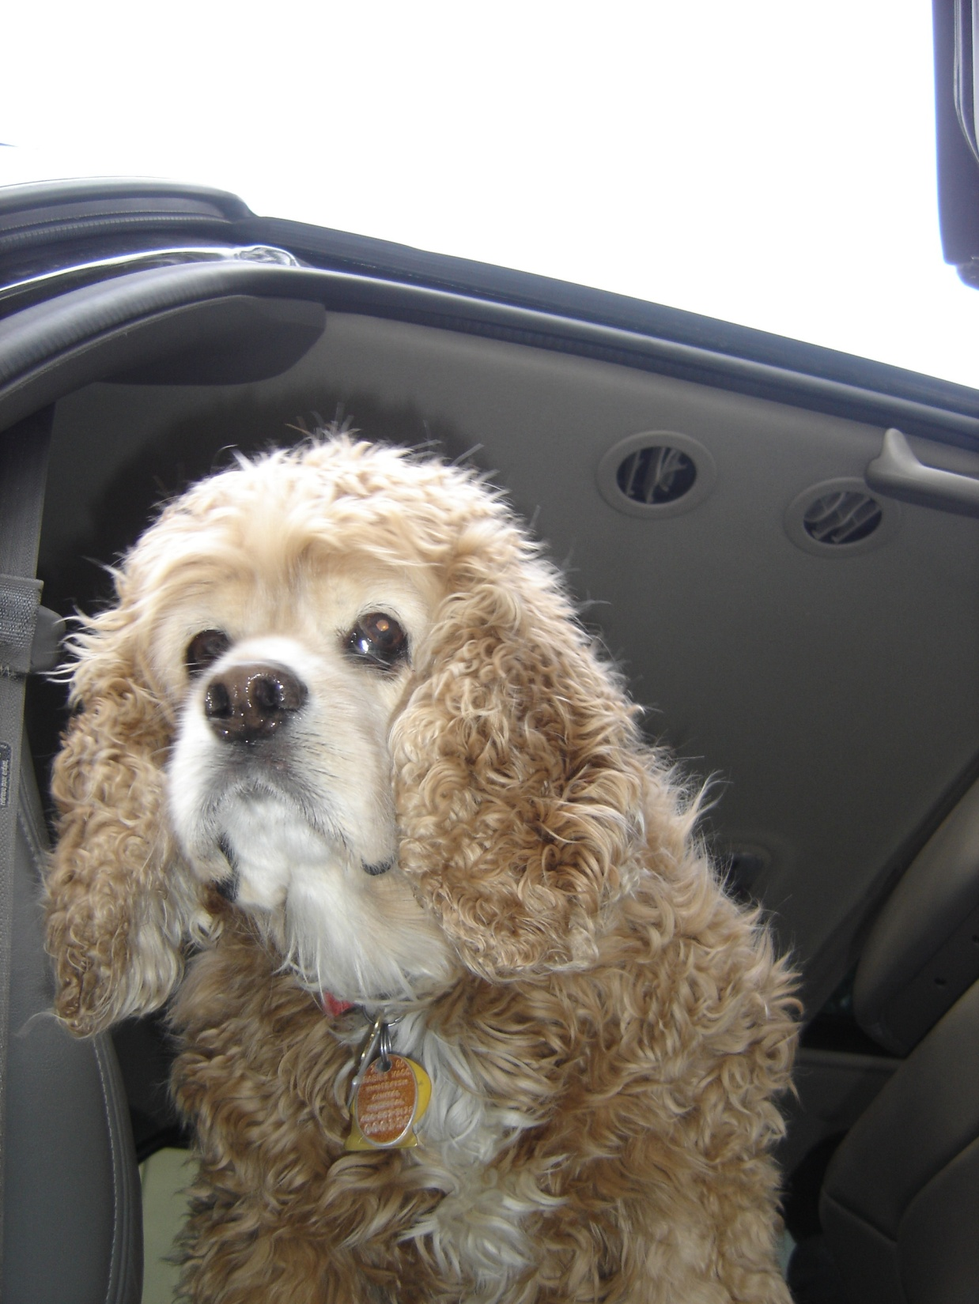
Back from a ride – April 2008

Slide 20
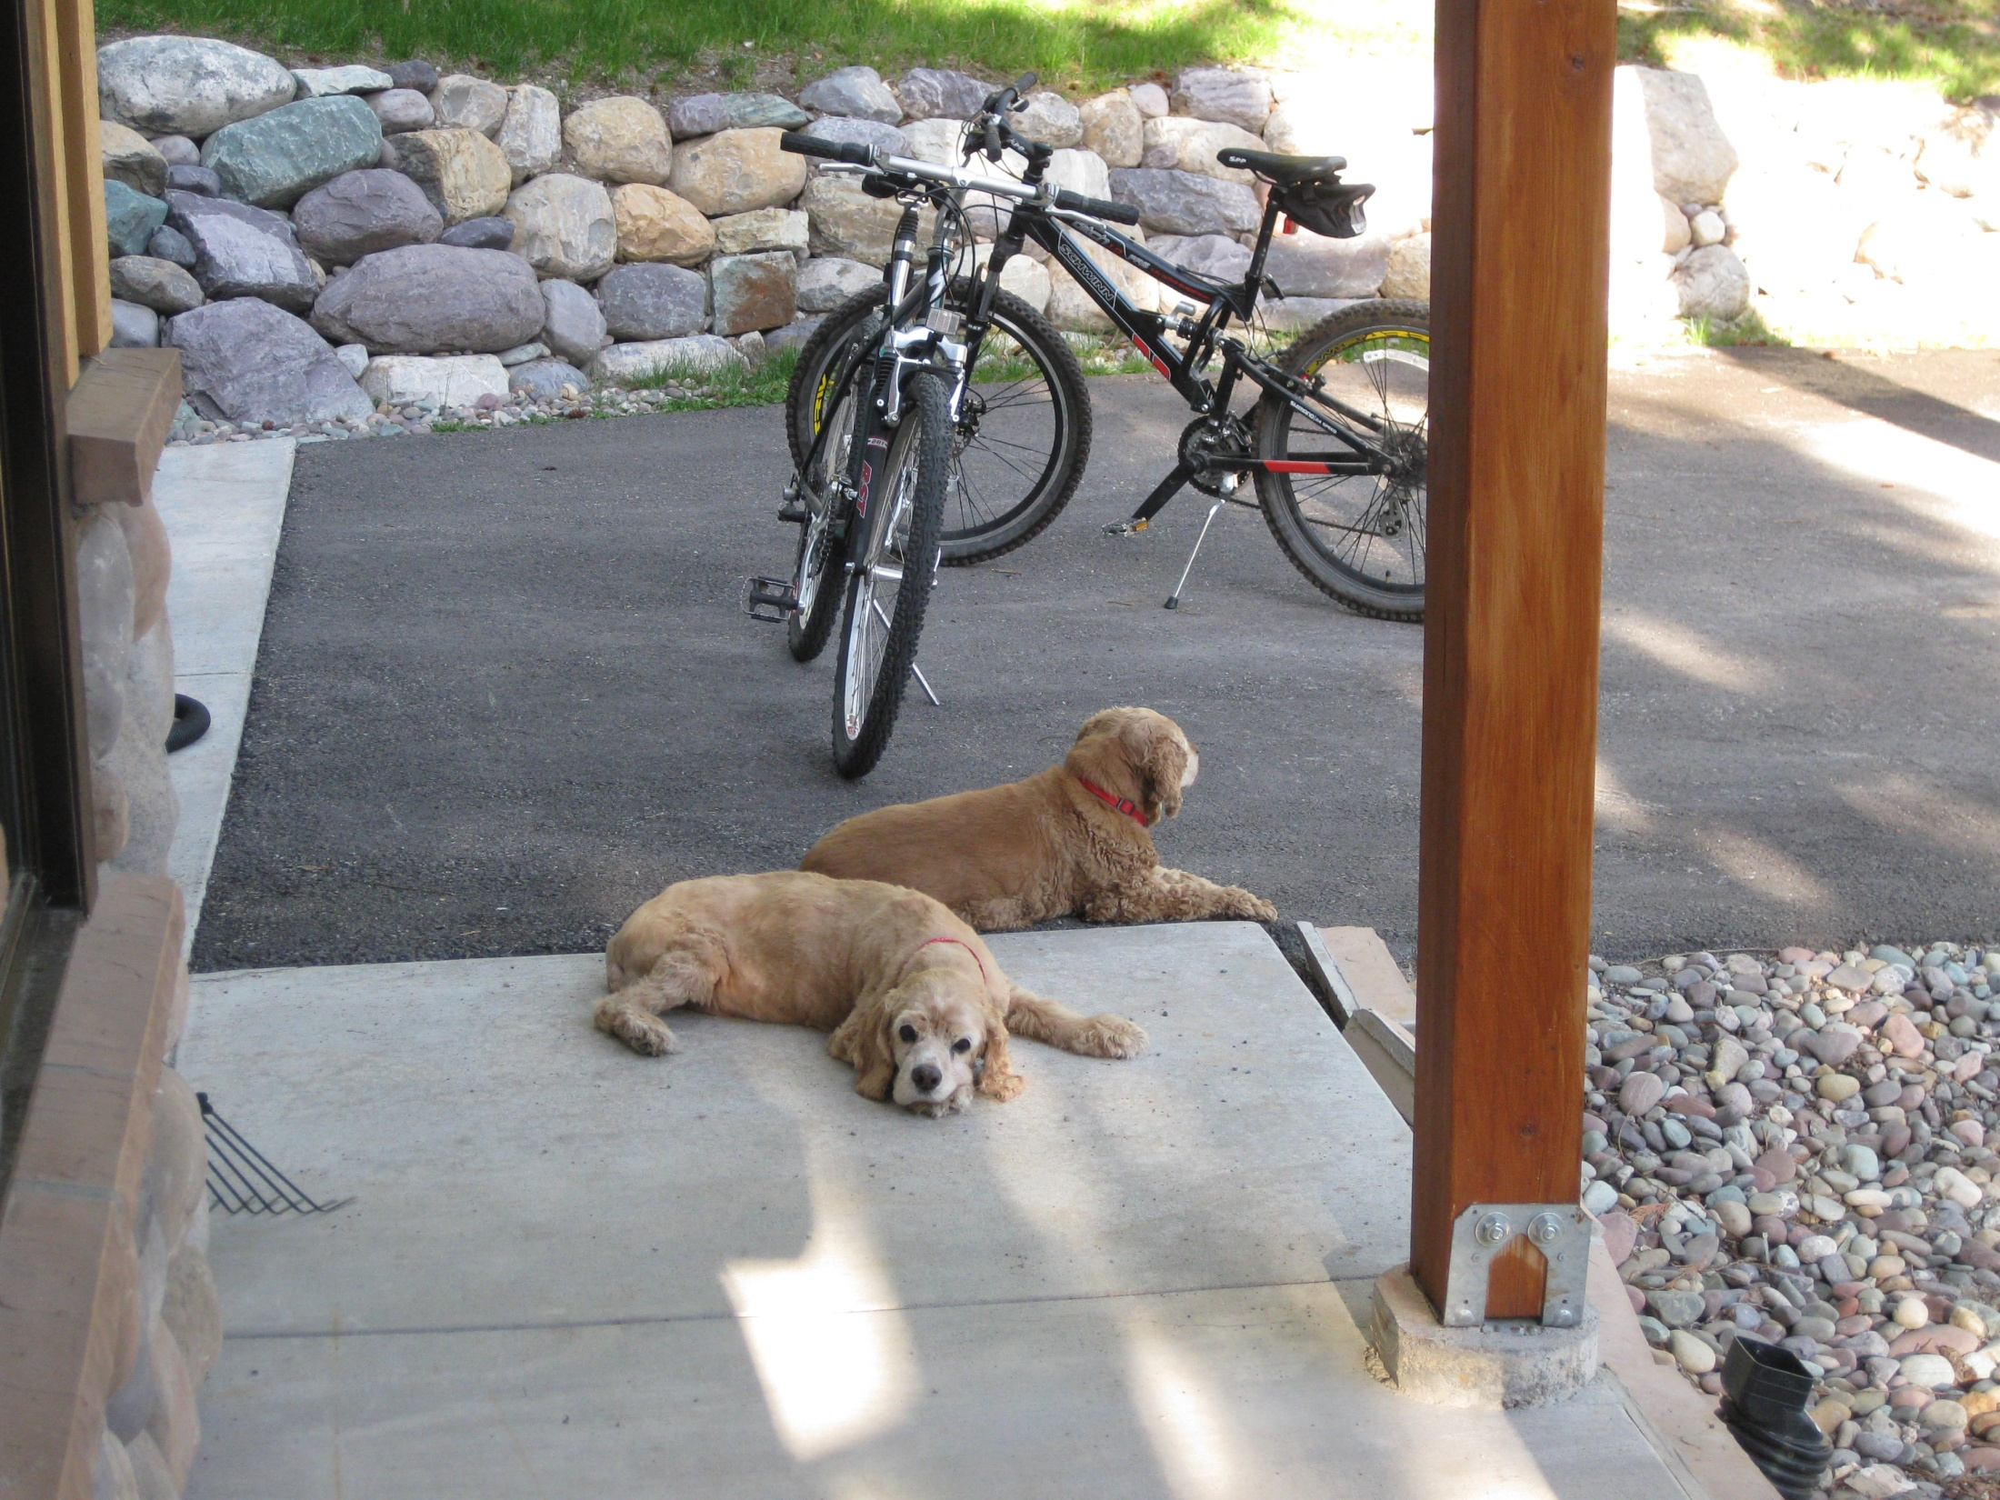
Sick and tired but still focused - Summer 2009

Slide 21
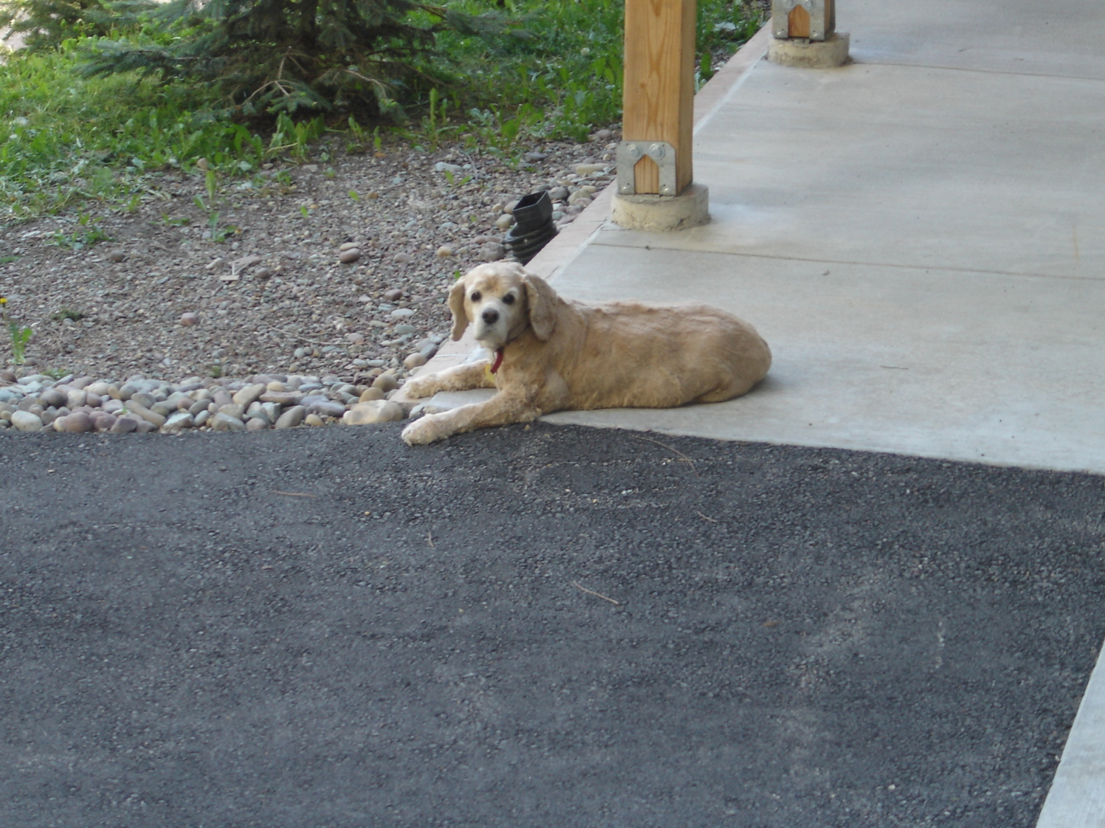
Uncle Jay’s best fan - Summer 2009

Slide 22
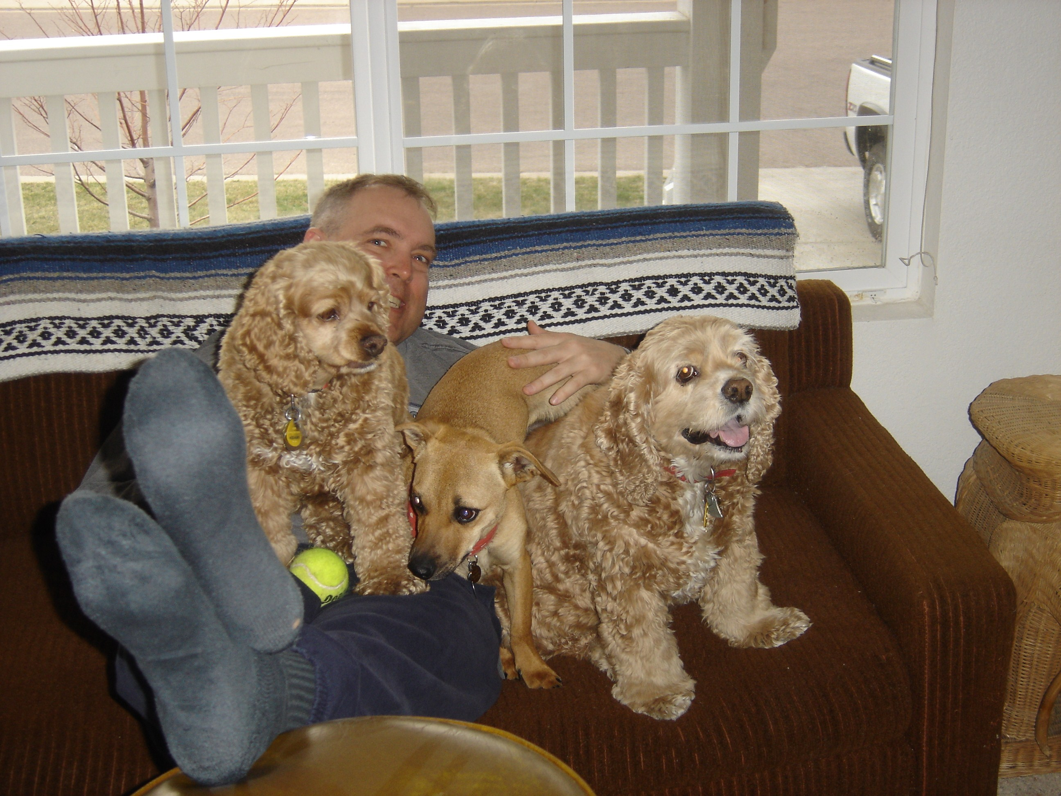

Slide 23
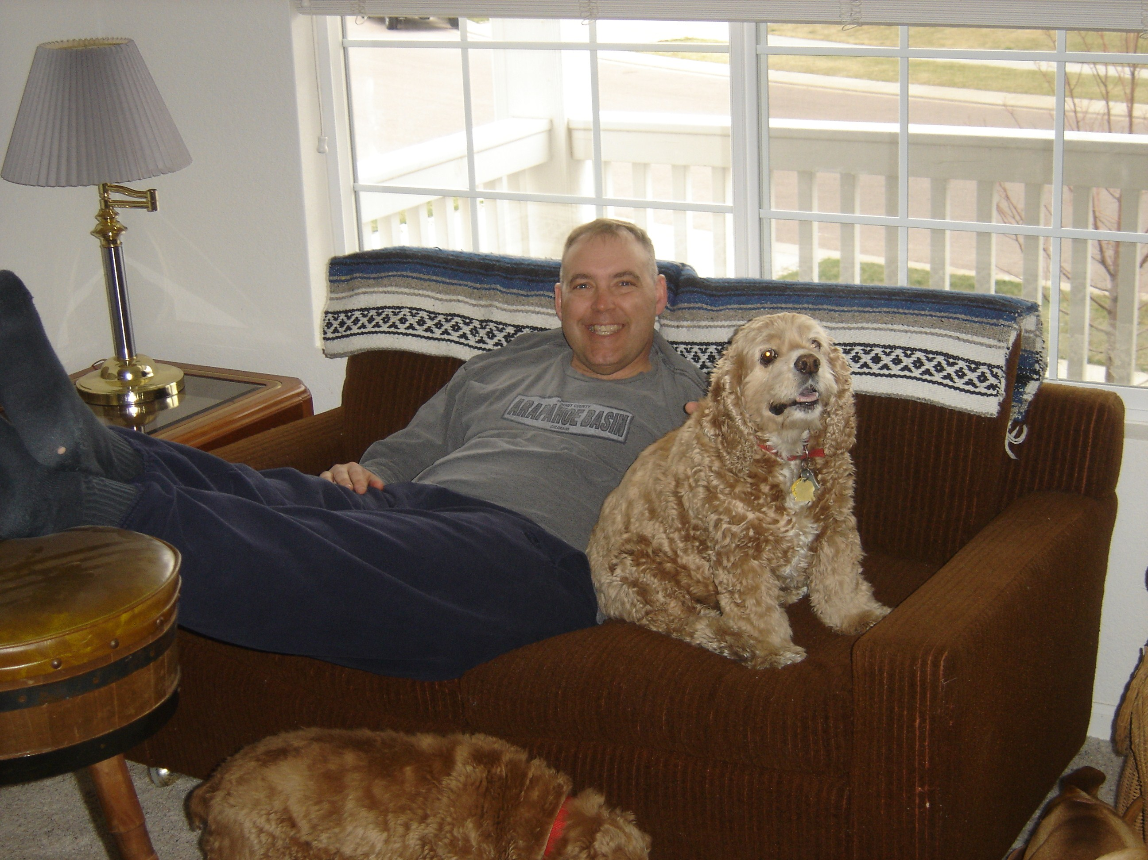

Slide 24
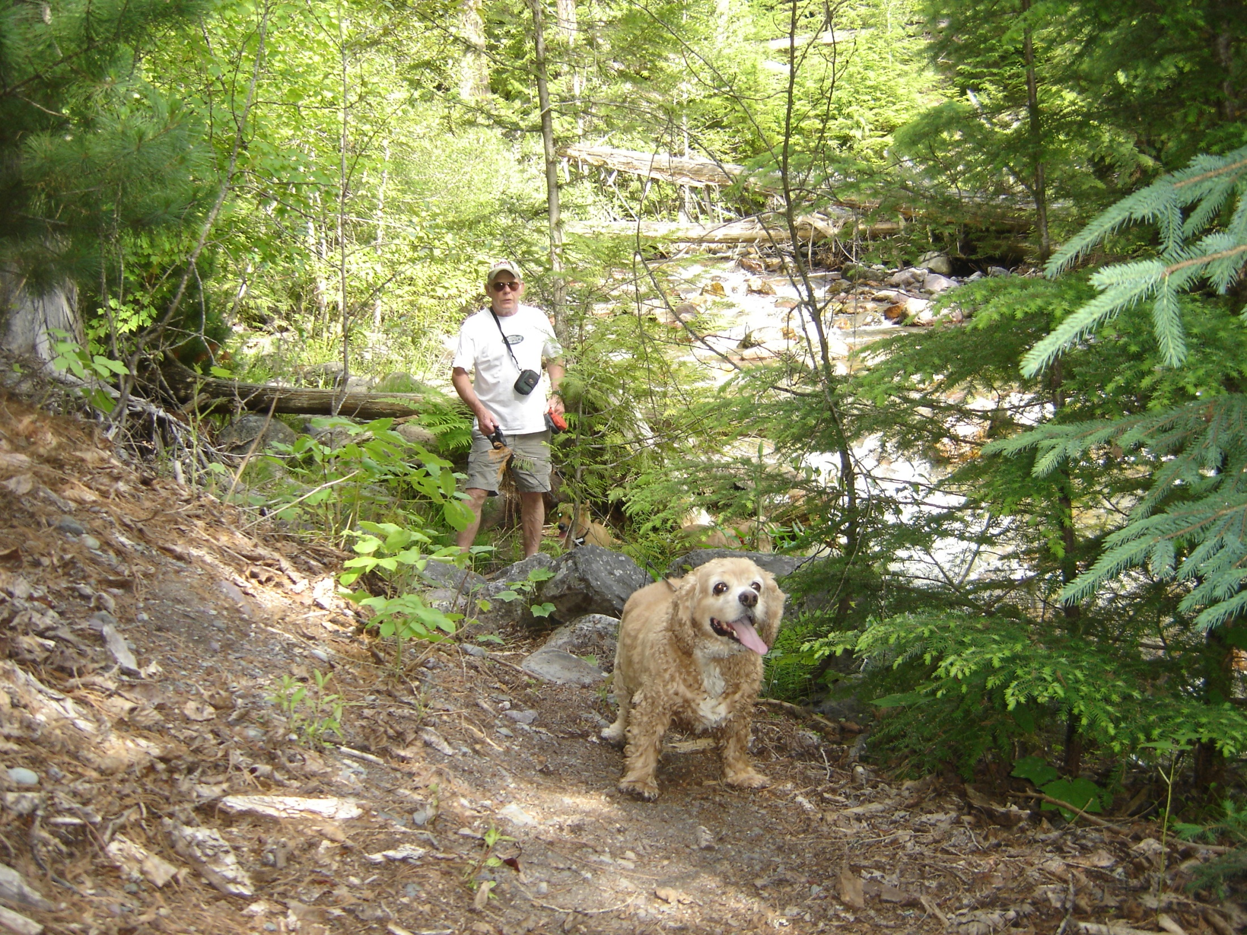
Glacier Park 2007 – Big Smile

Slide 25
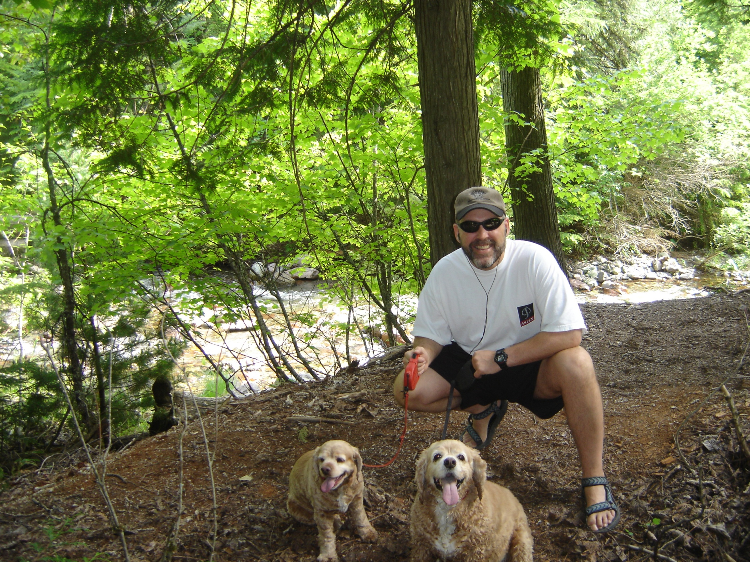

Slide 26
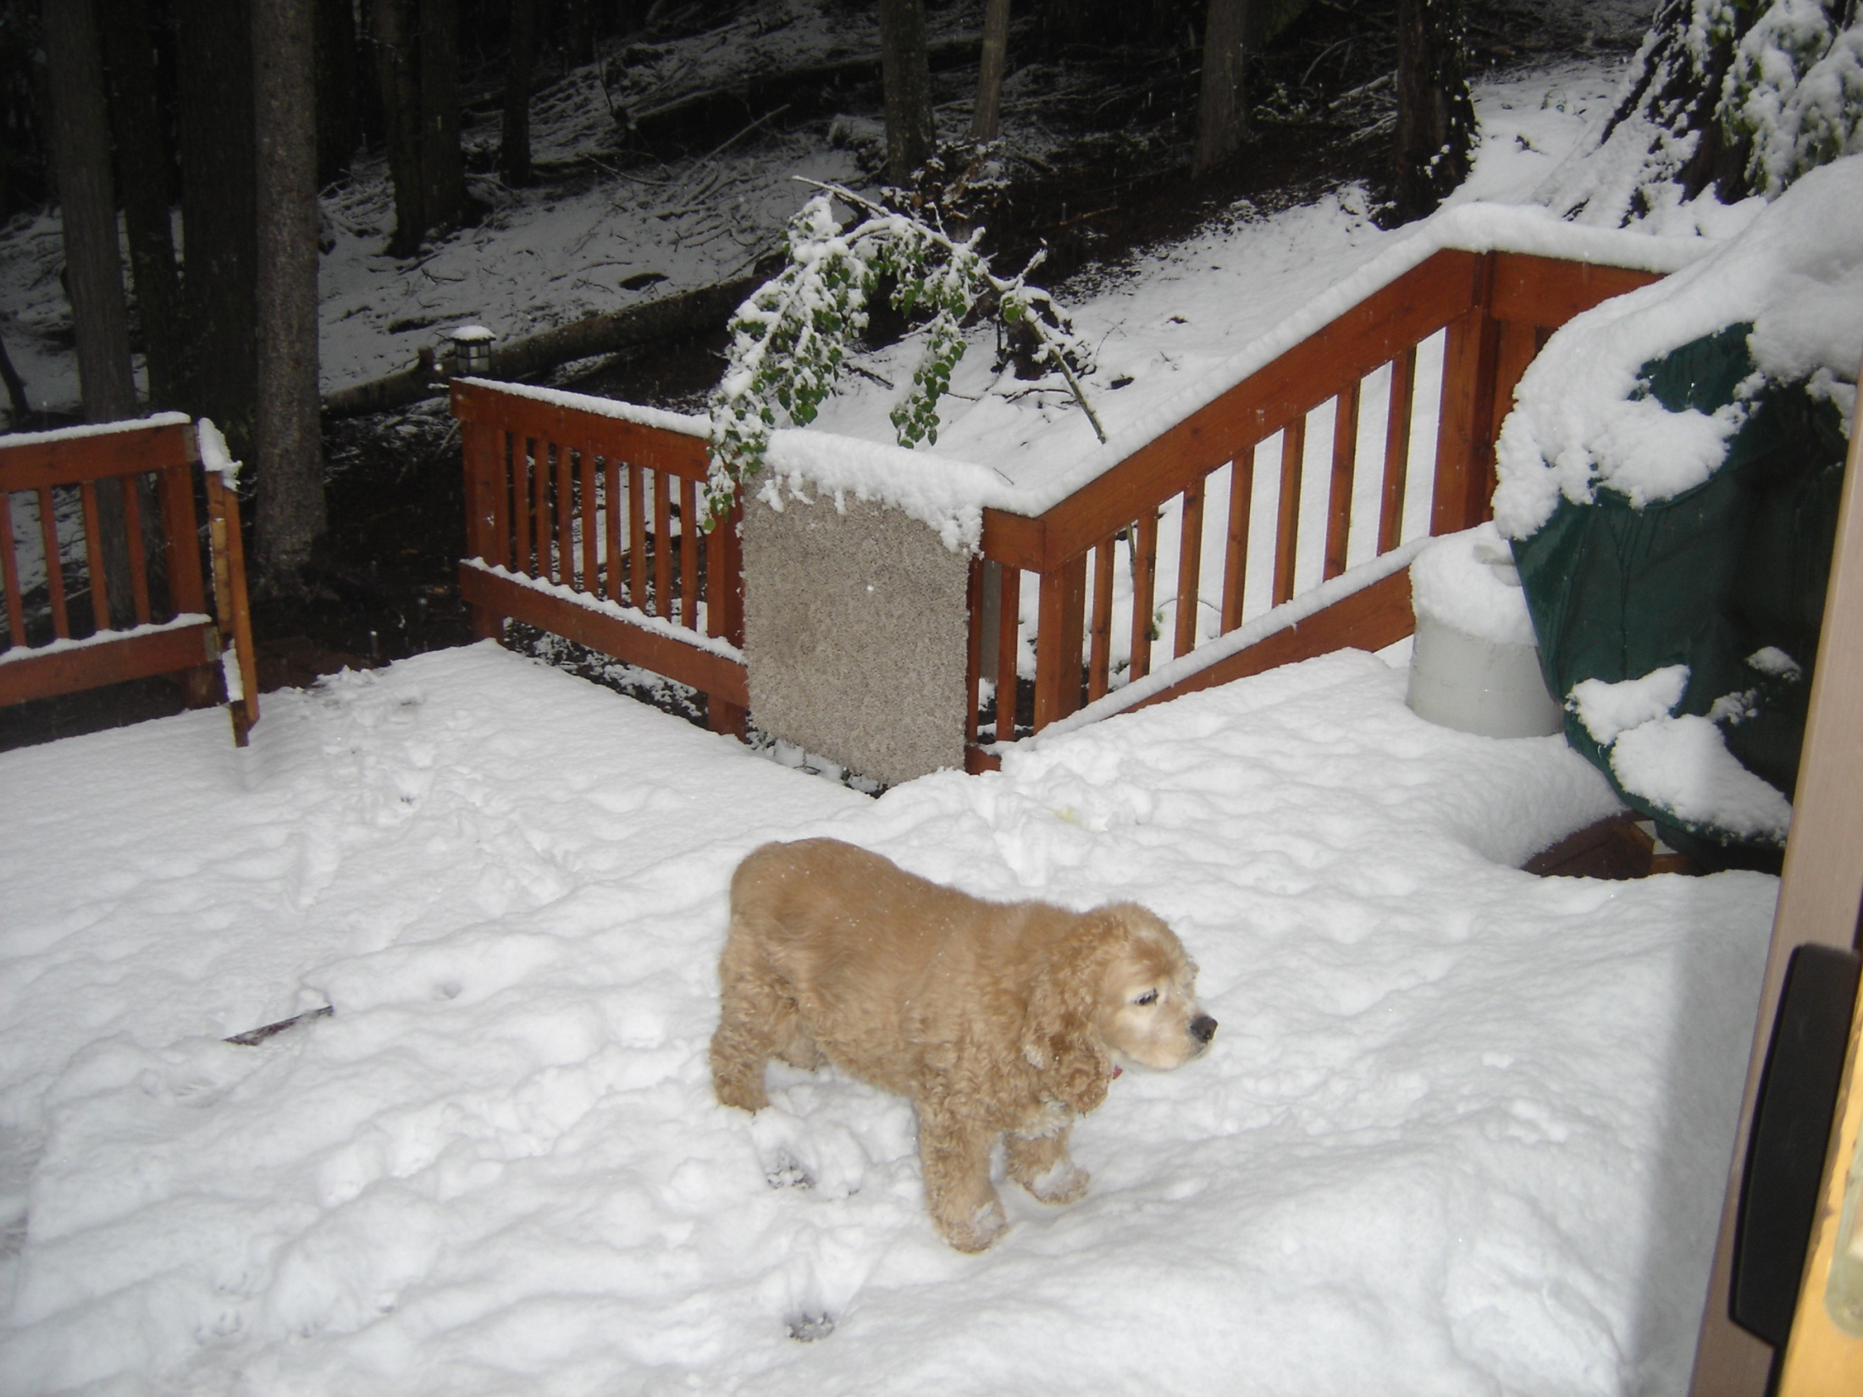
Scoober in her element – 4 inches of snow June 10, 2008

Slide 27
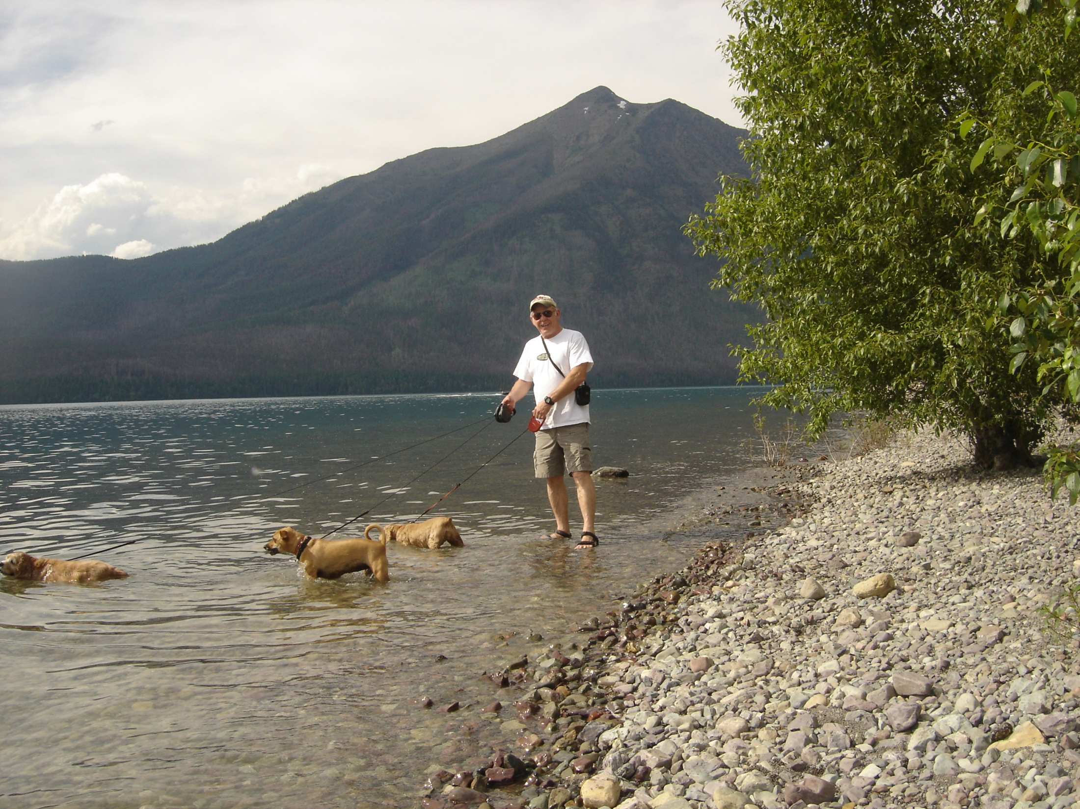
Scoober - First in the water every time
Lake McDonald
Glacier Park 2007

Slide 28
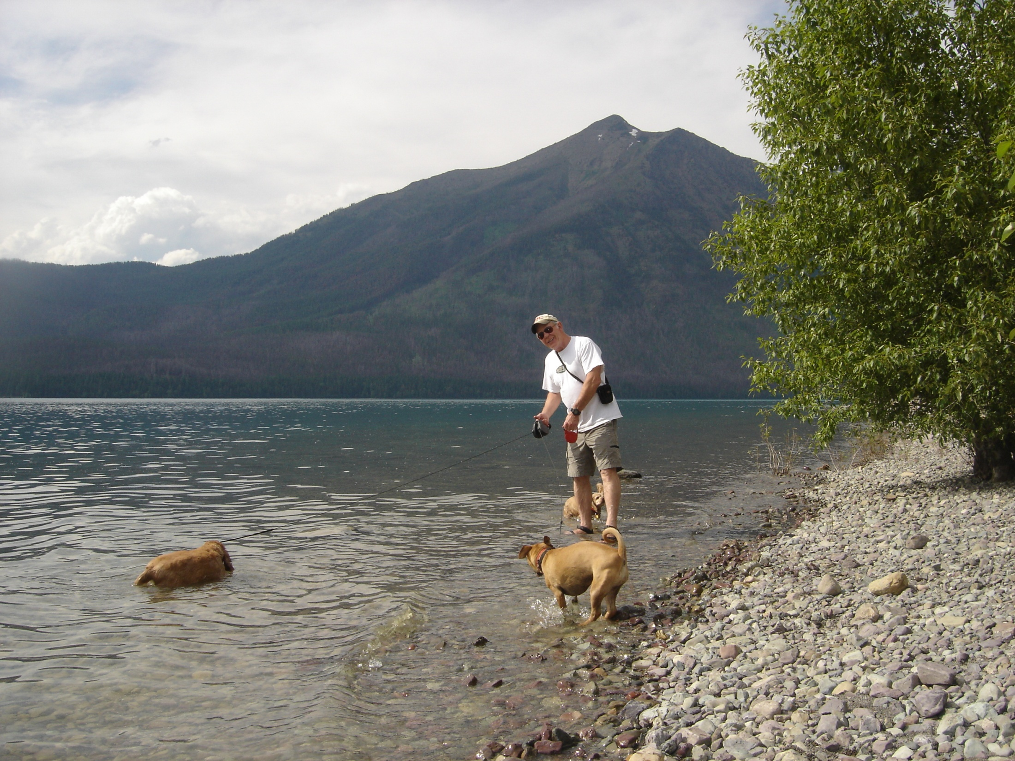

Slide 29
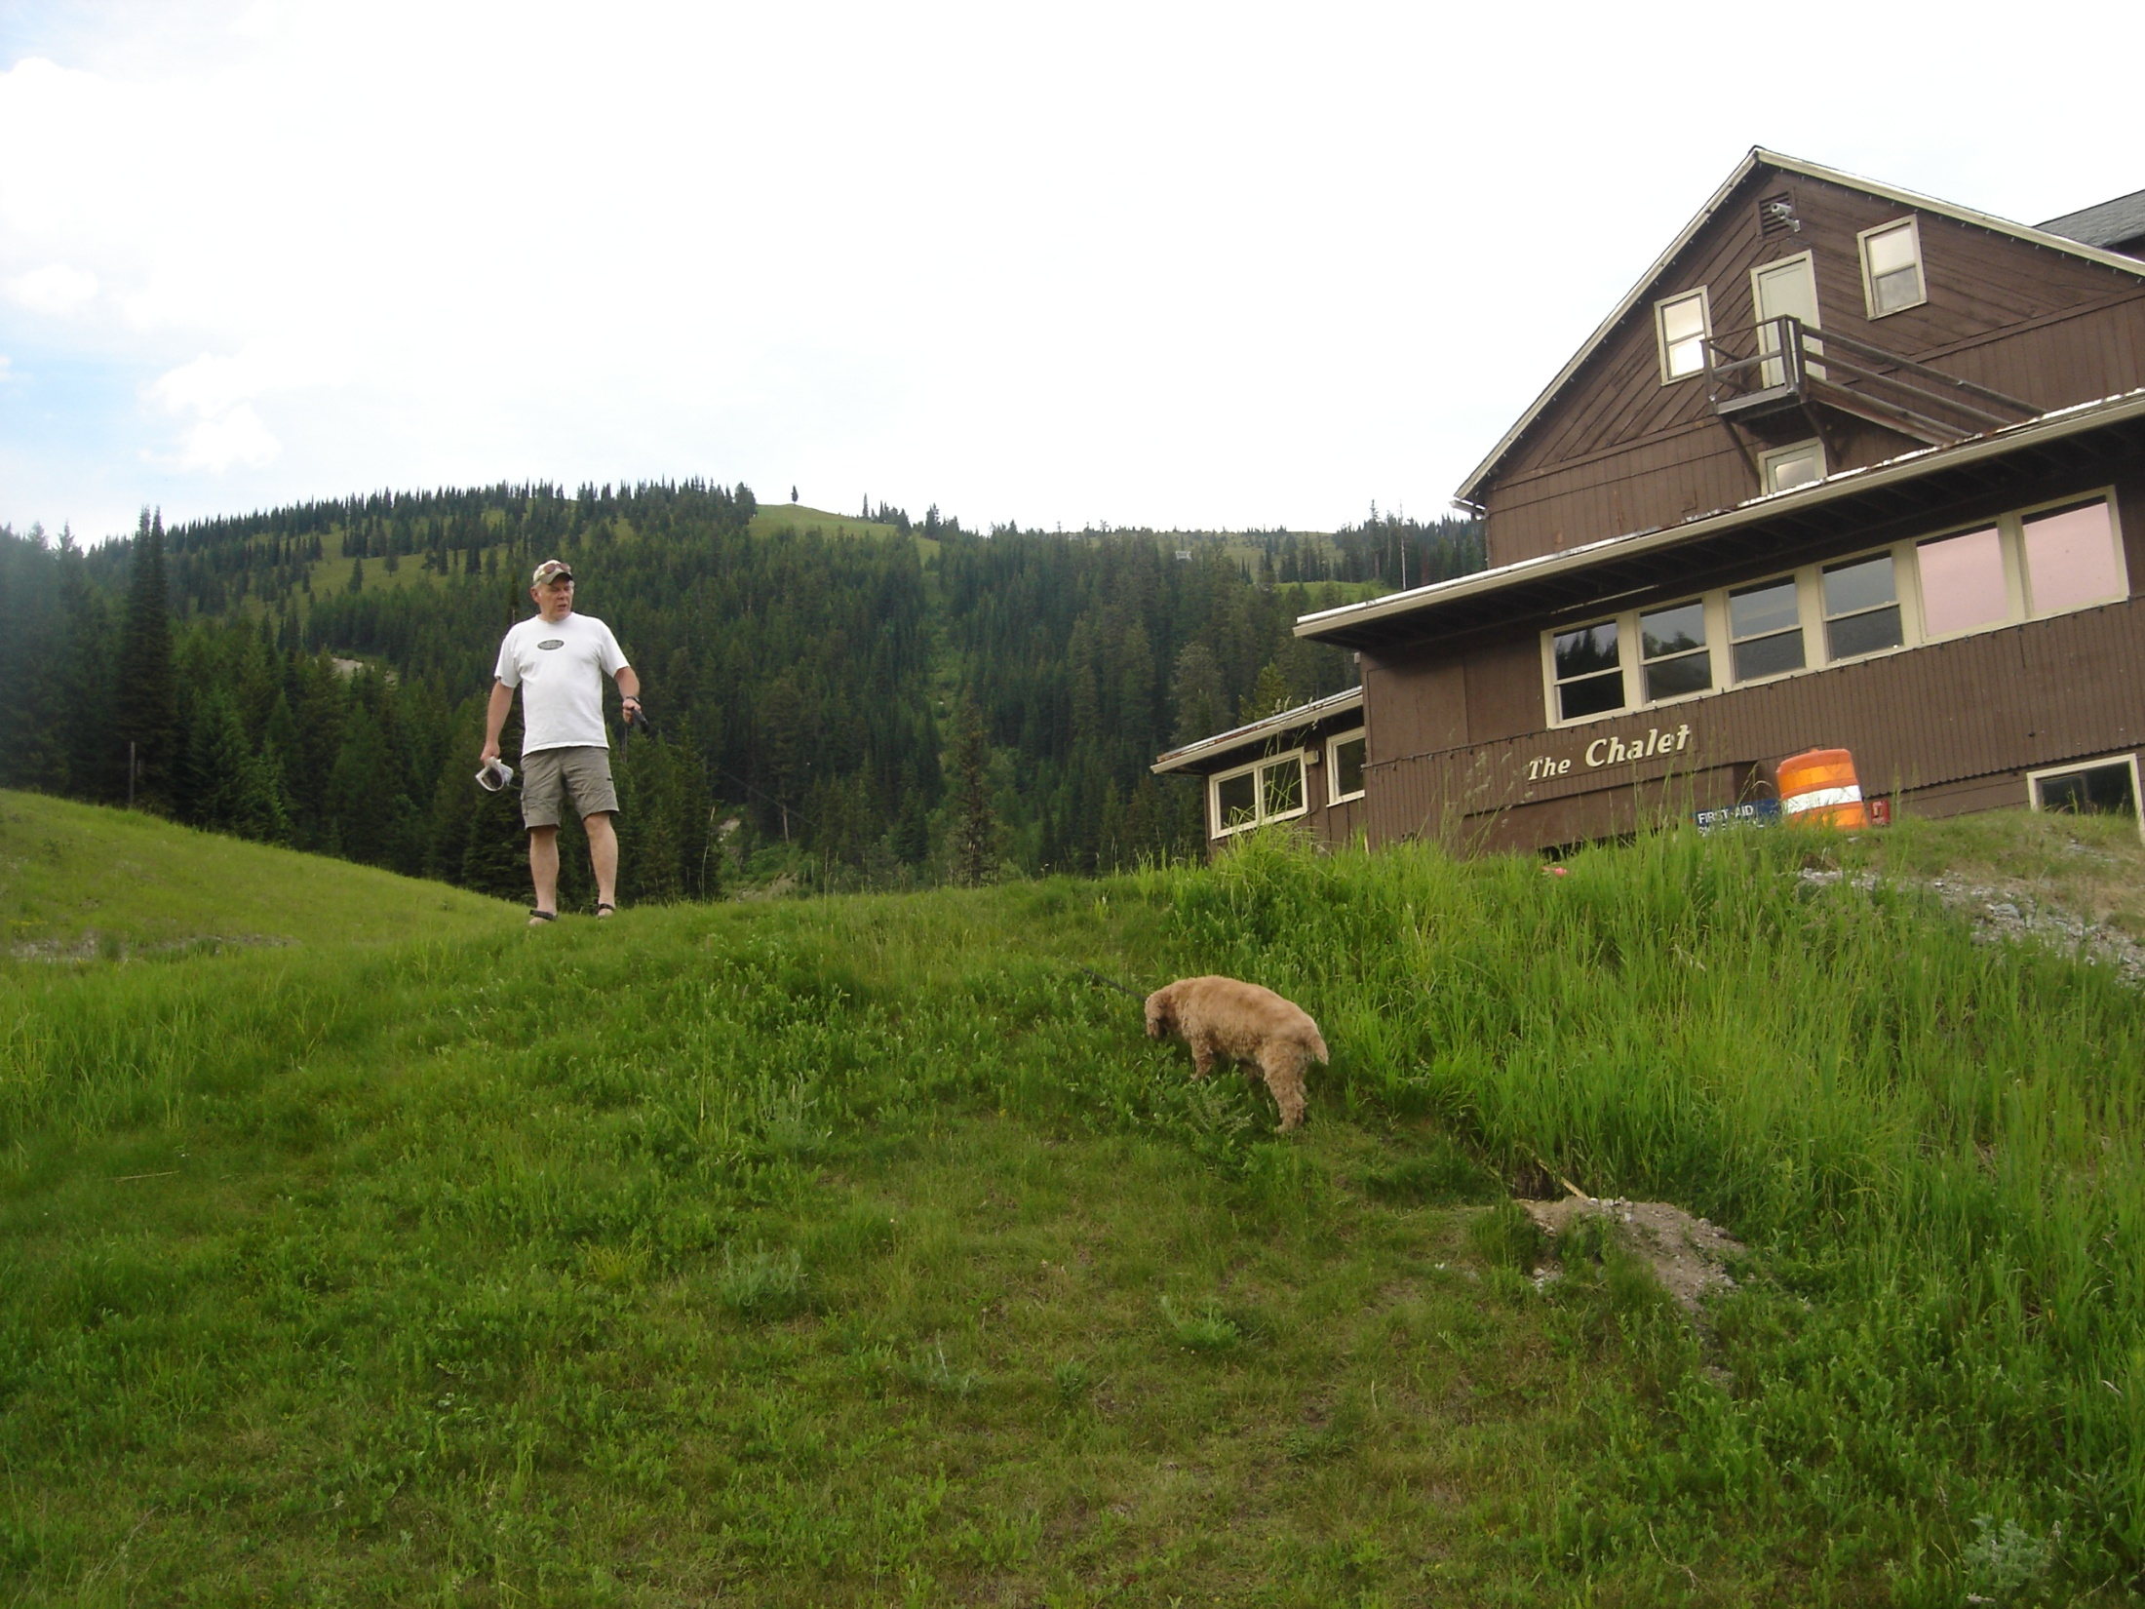
Big Mountain Dog - Summer 2007

Slide 30
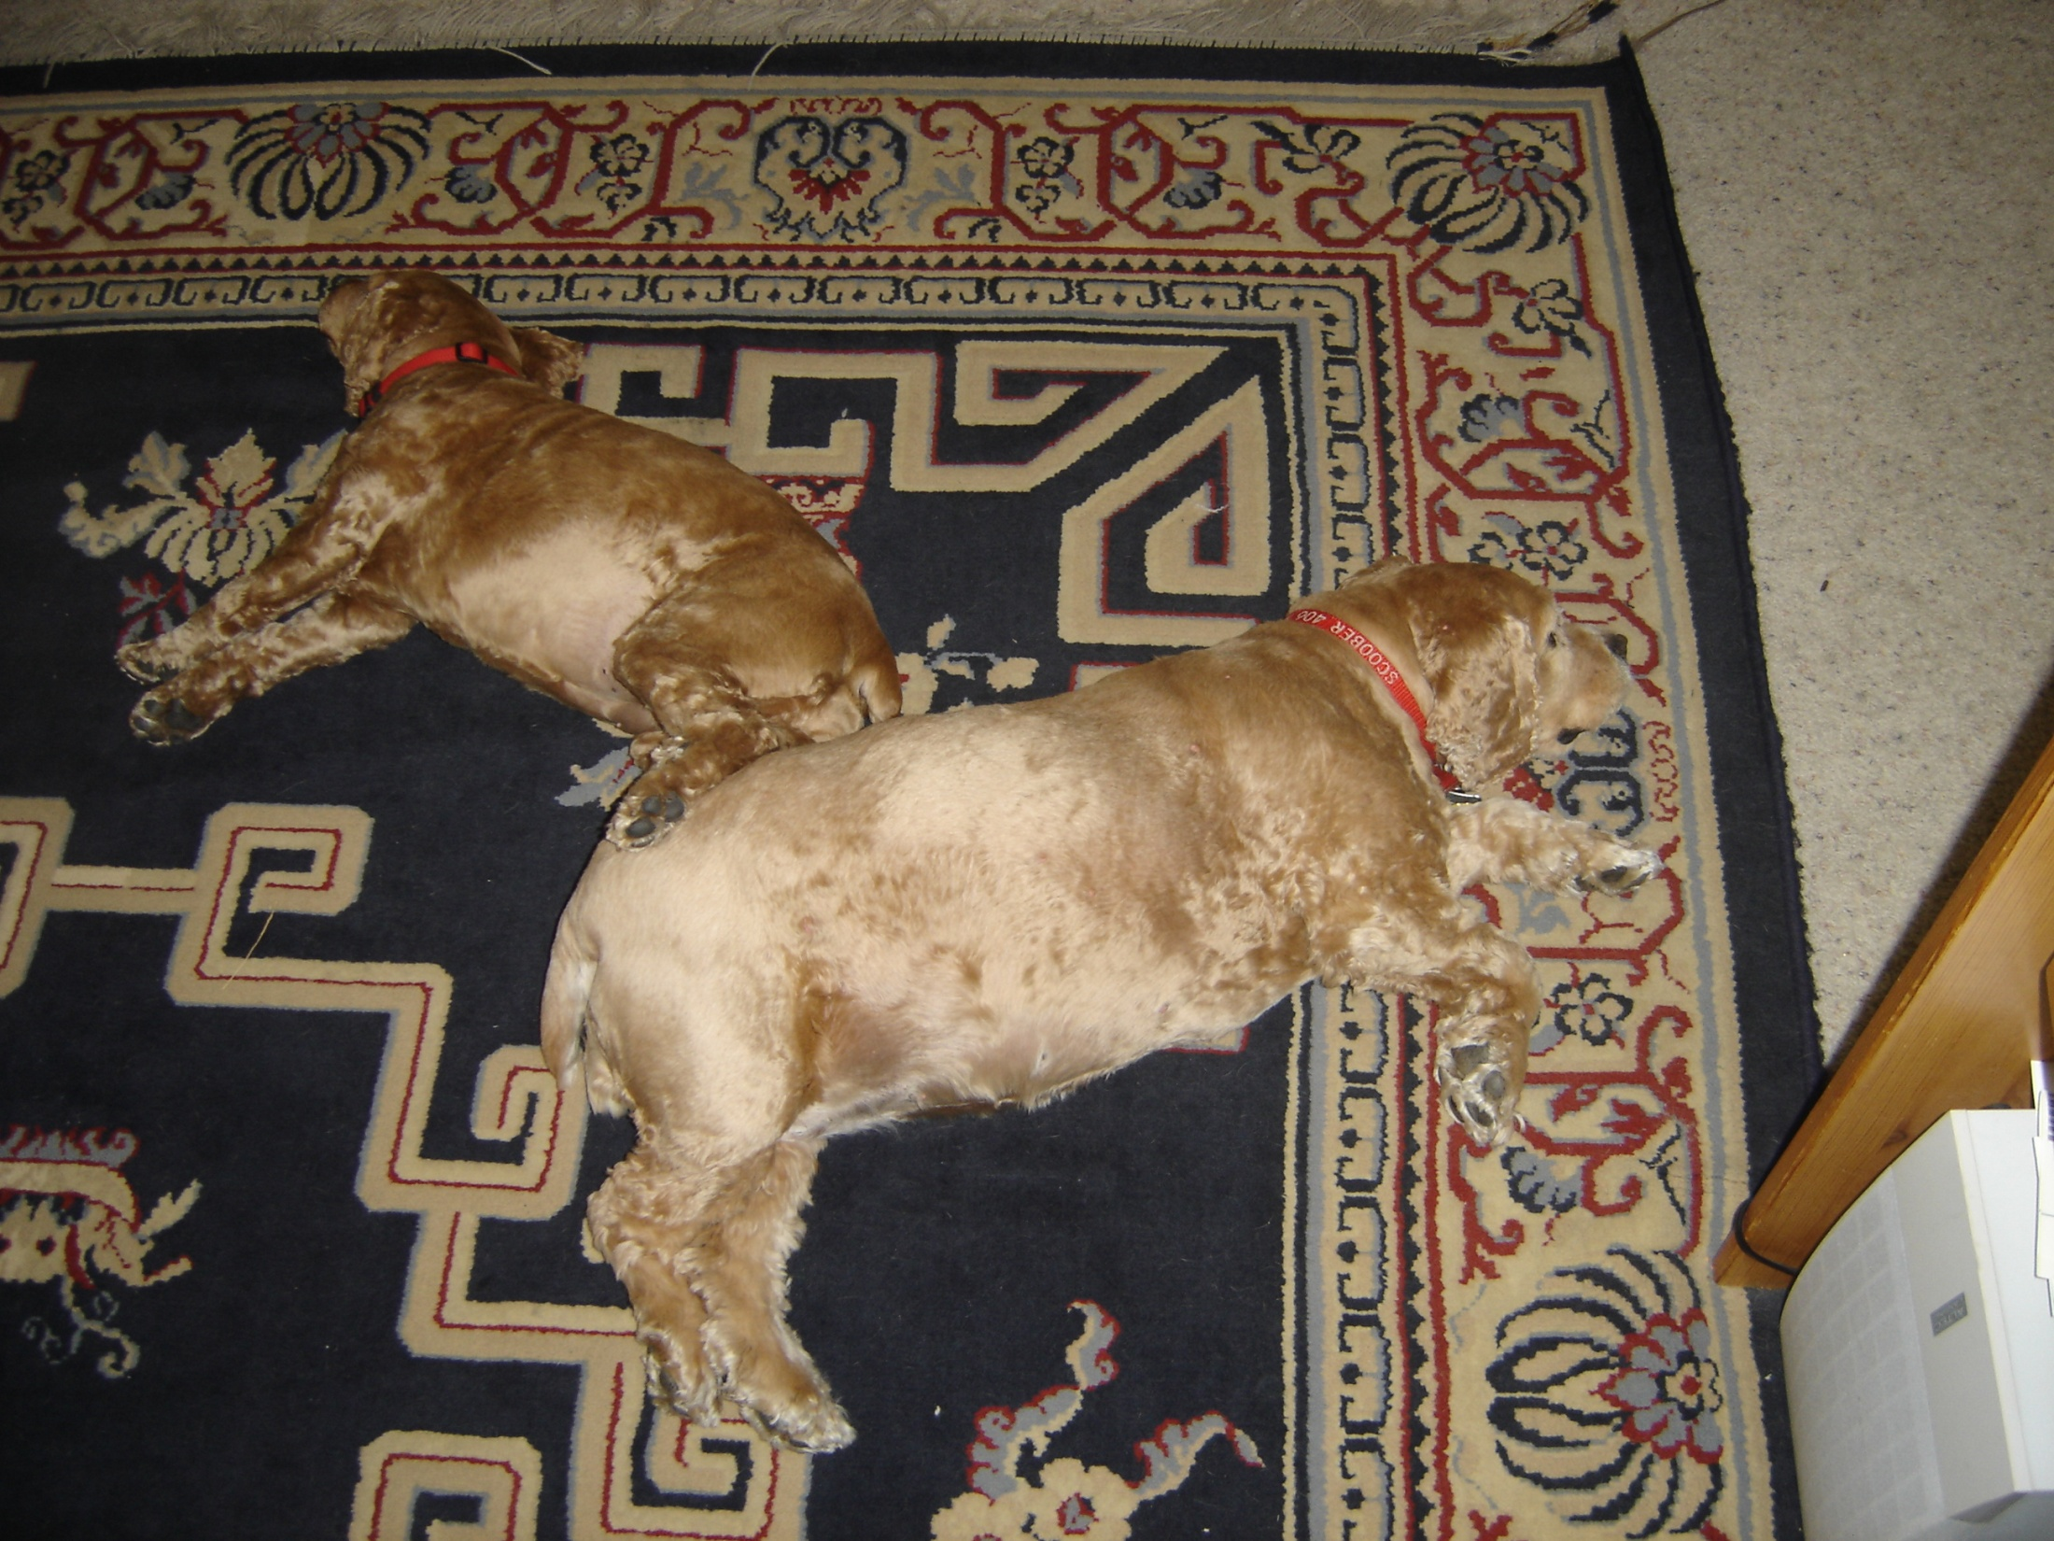
Sparta Girl Chunky - 2005

Slide 31
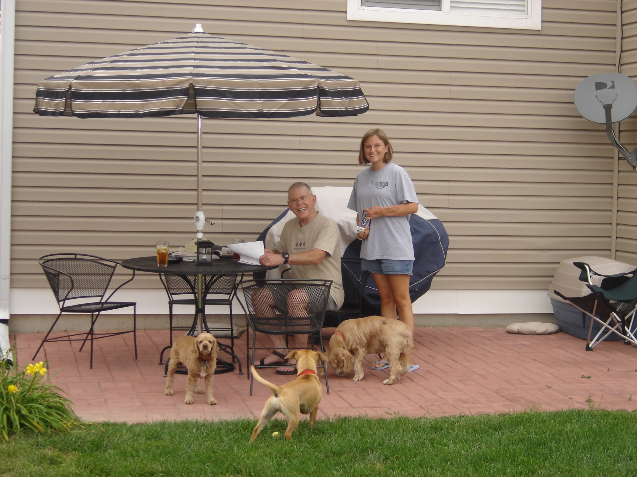

Slide 32
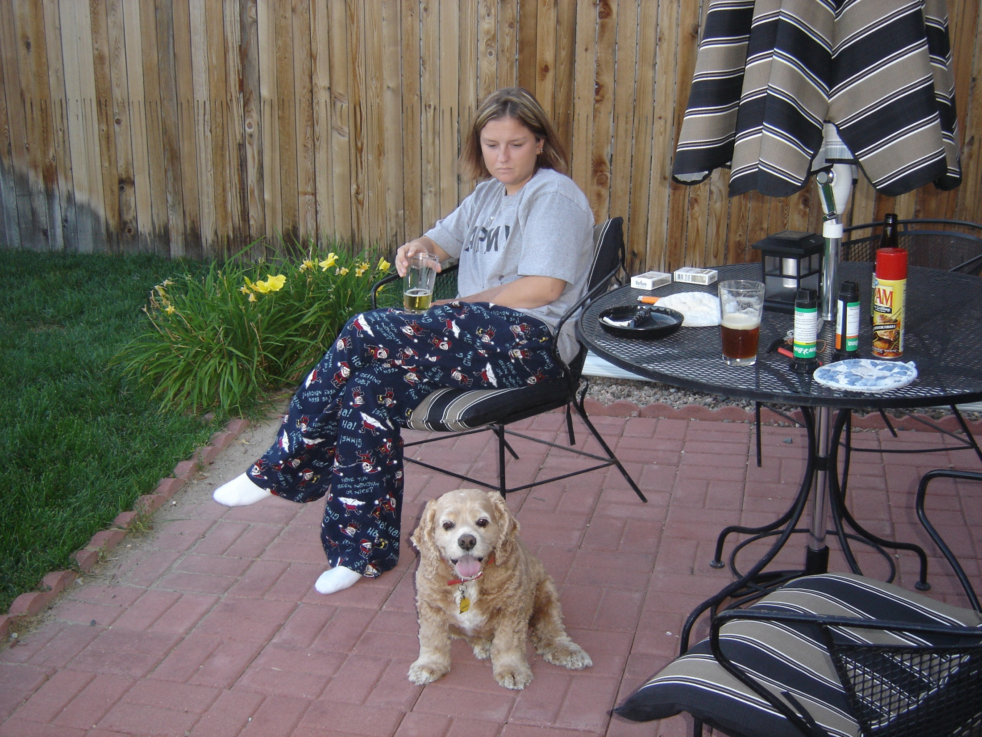

Slide 33
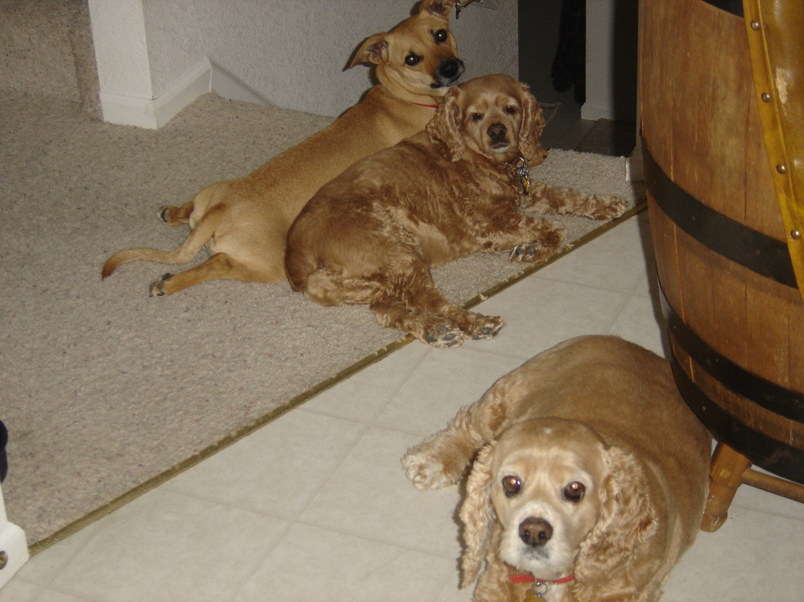

Slide 34
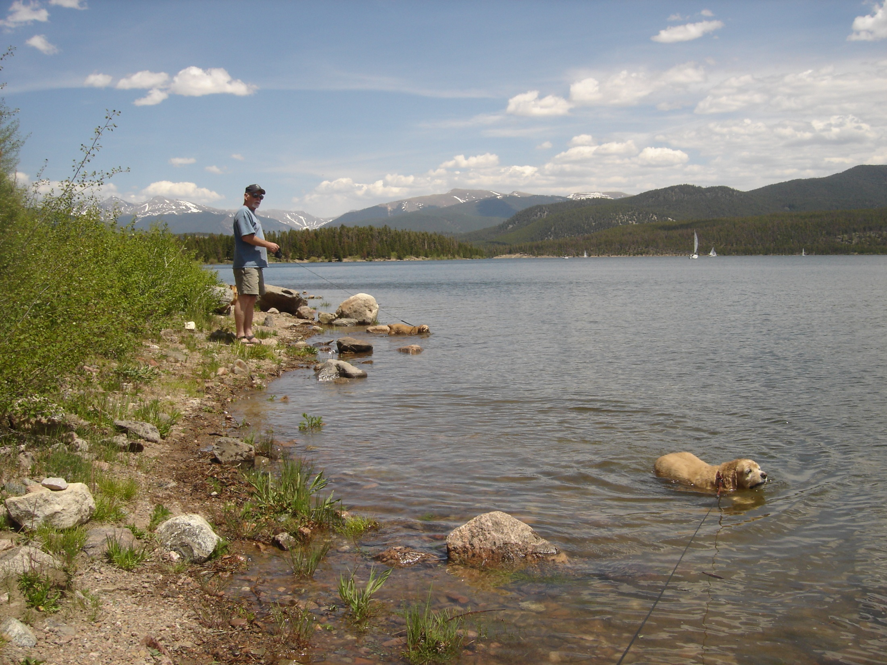
Lake Dillon,
Summit County
Colorado 2006

Slide 35
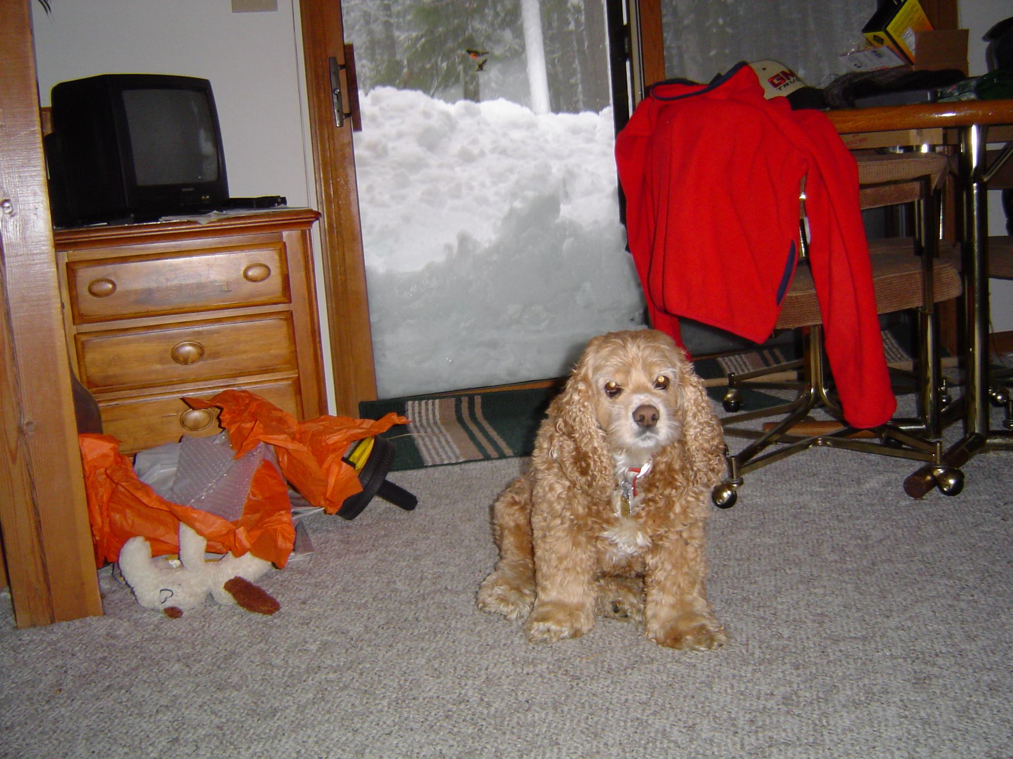
“You’re going skiing again?” - Jan 2004

Slide 36
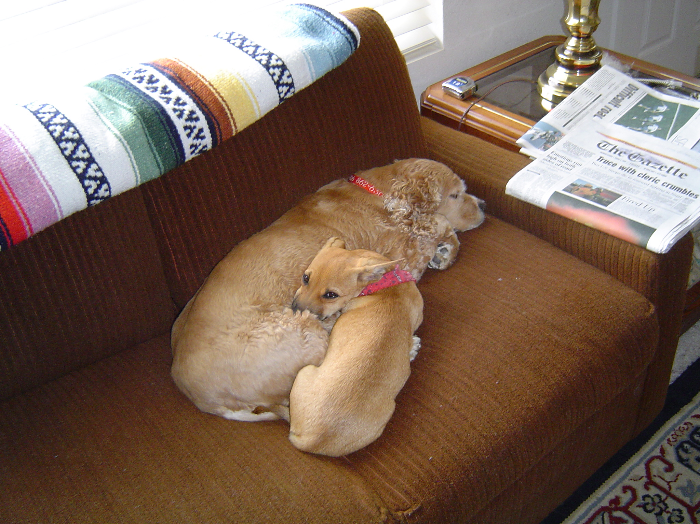

Slide 37
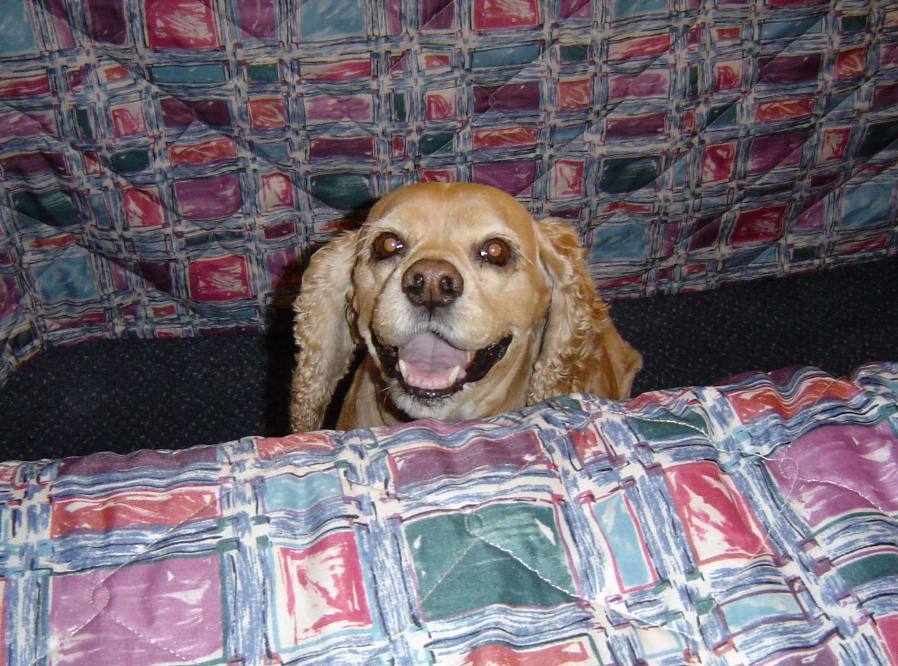
“I see you Uncle Jay” - July 2004

Slide 38
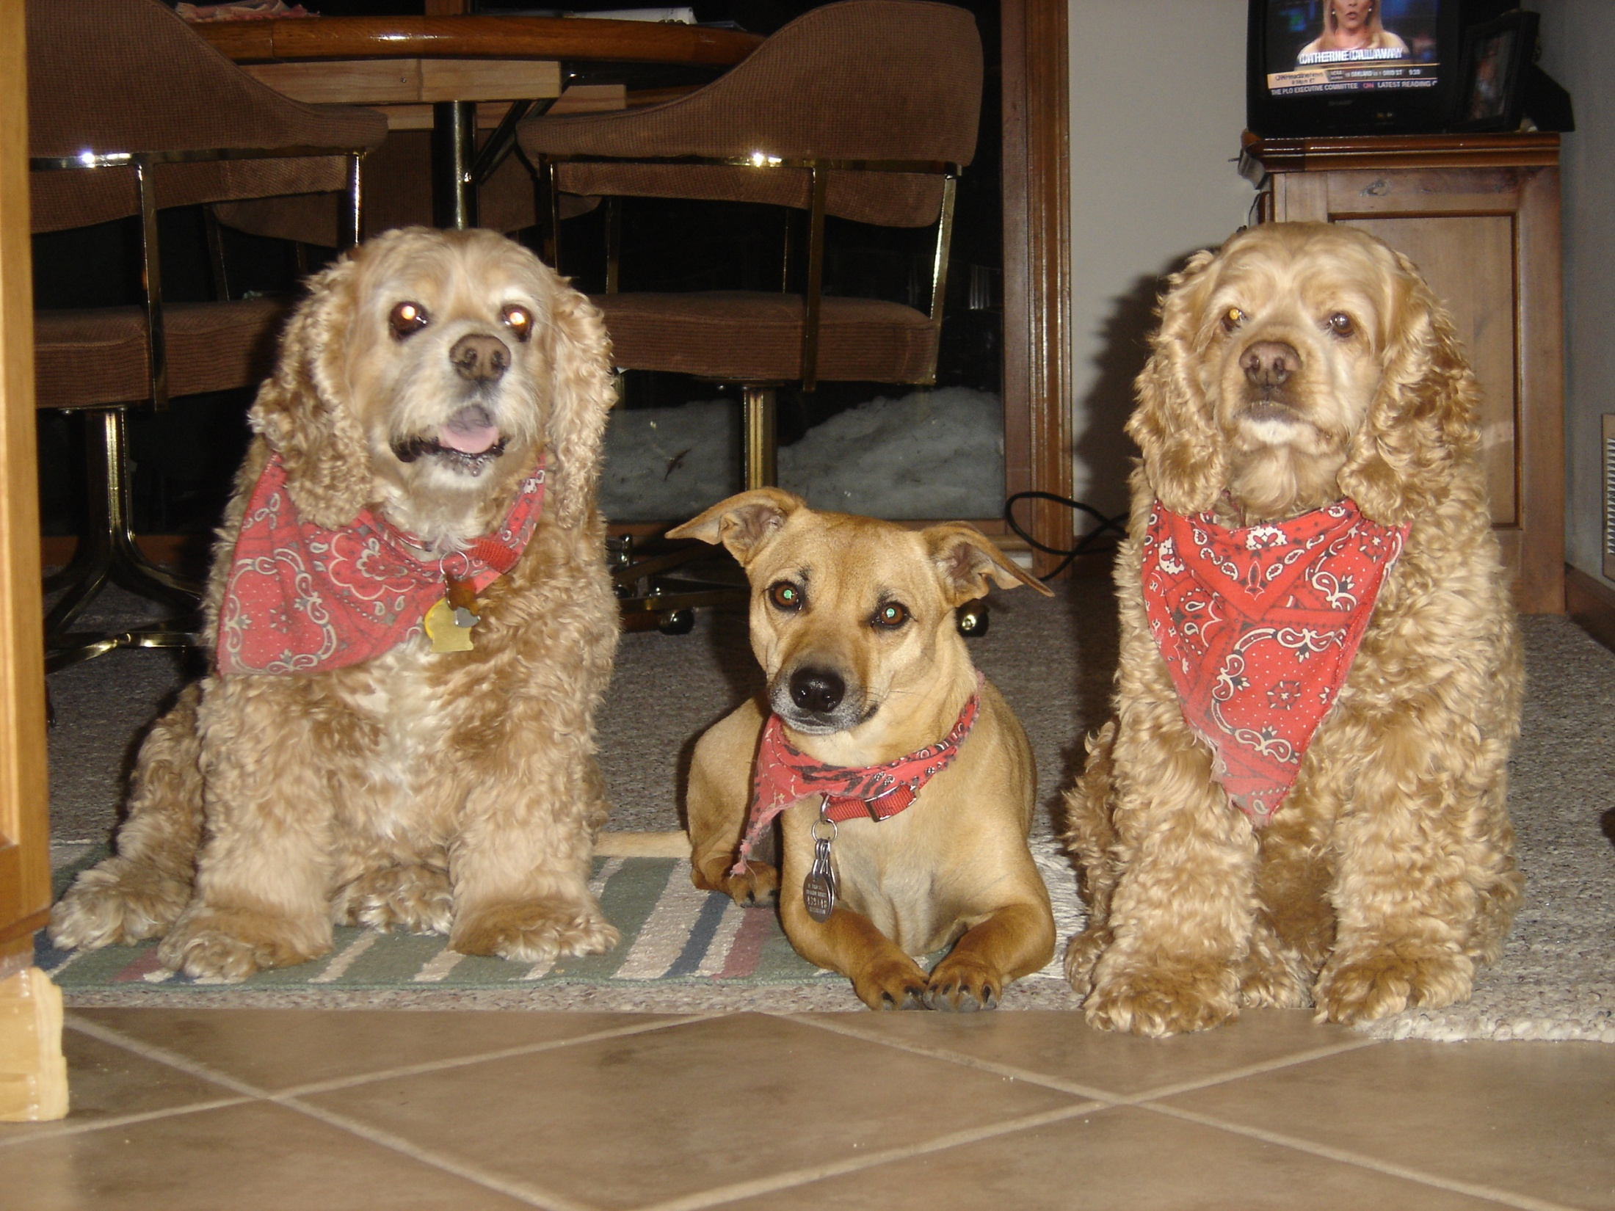

Slide 39
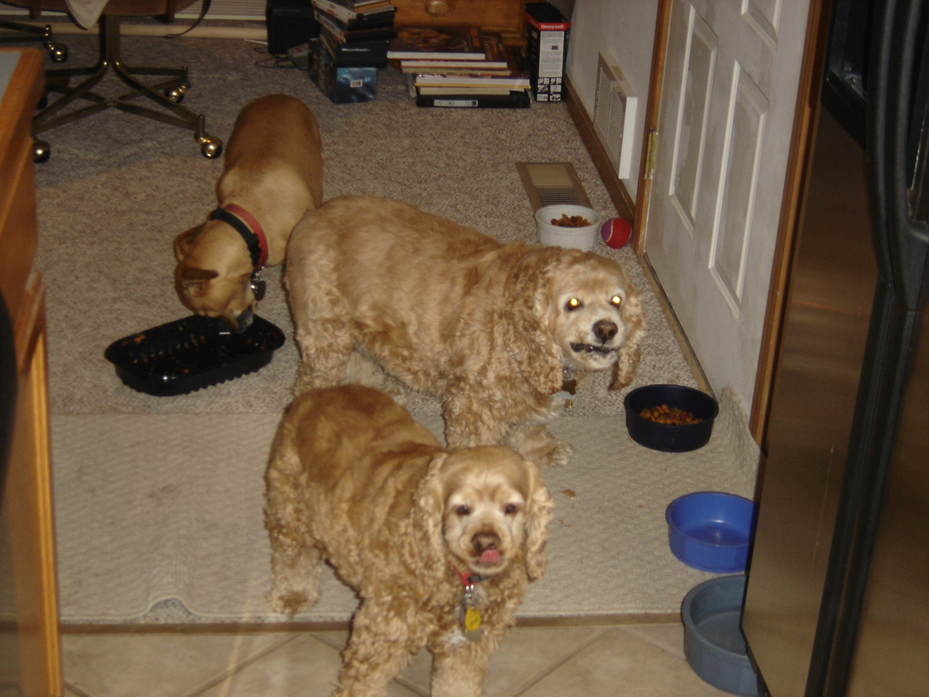
Spaghetti Pan Cleanup Detail

Slide 40
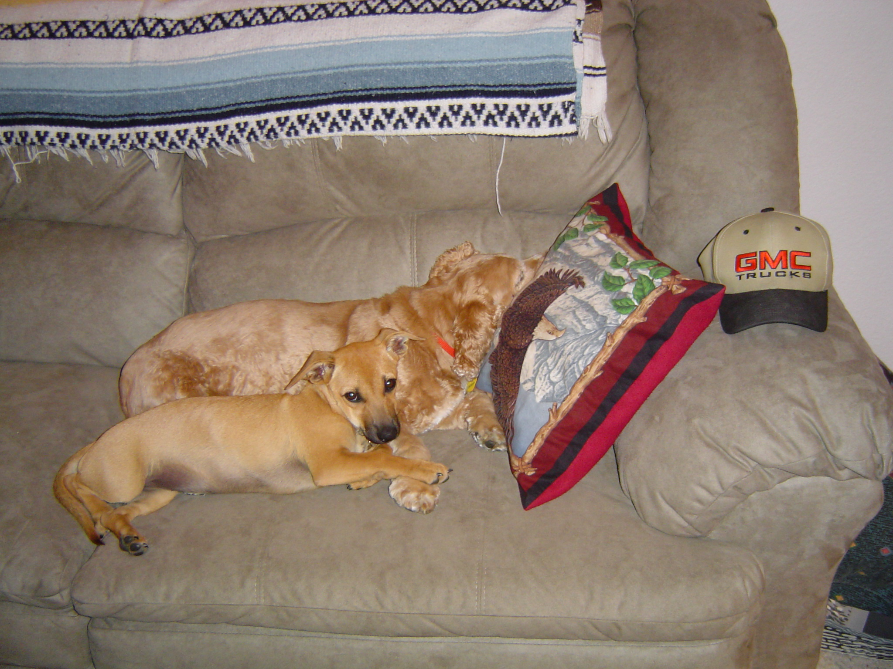
Rosie’s Mentor – Fall 2004

Slide 41
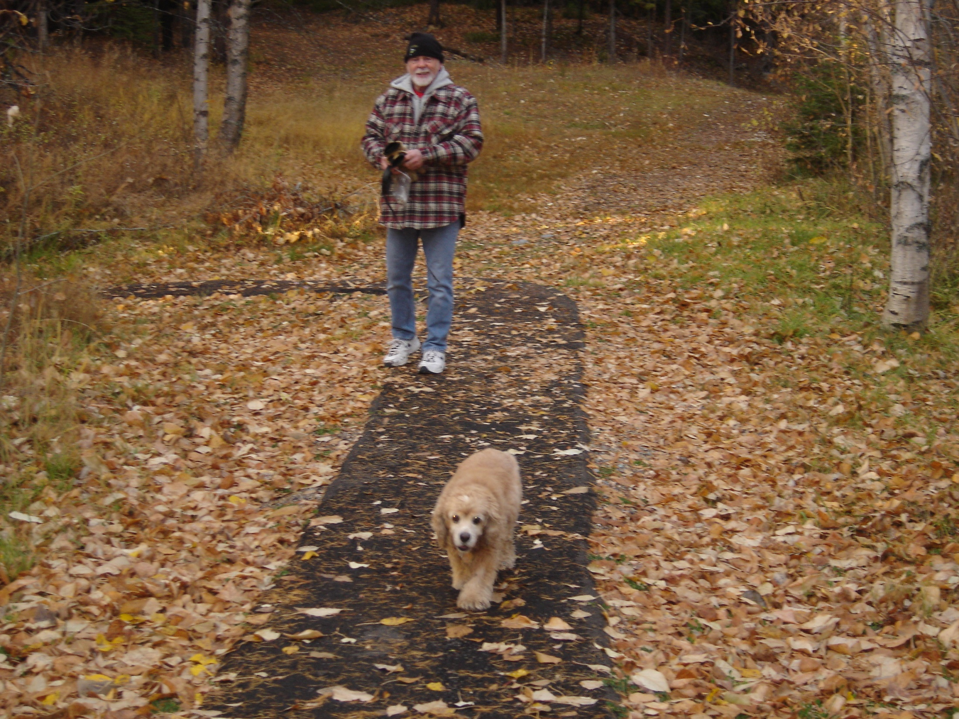
Best Friends – Ptarmigan Fall 2008

Slide 42
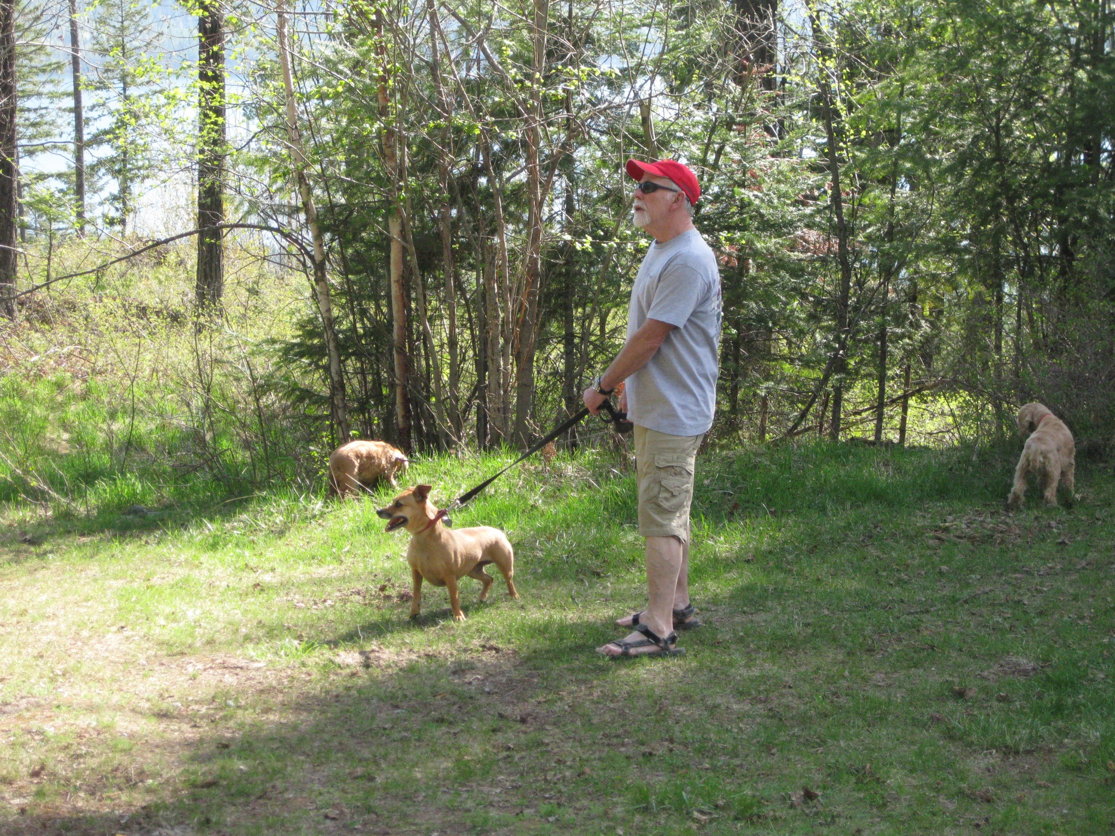
Ptarmigan Spring 2009

Slide 43
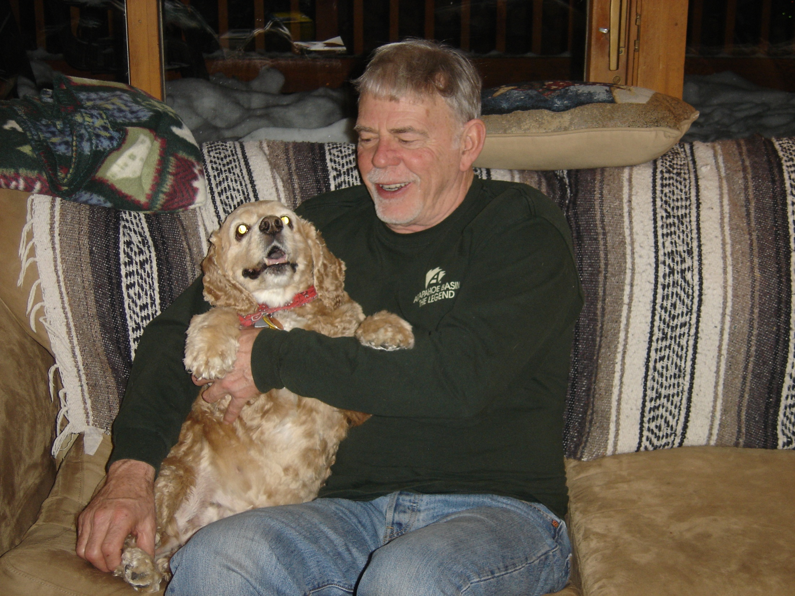

Slide 44
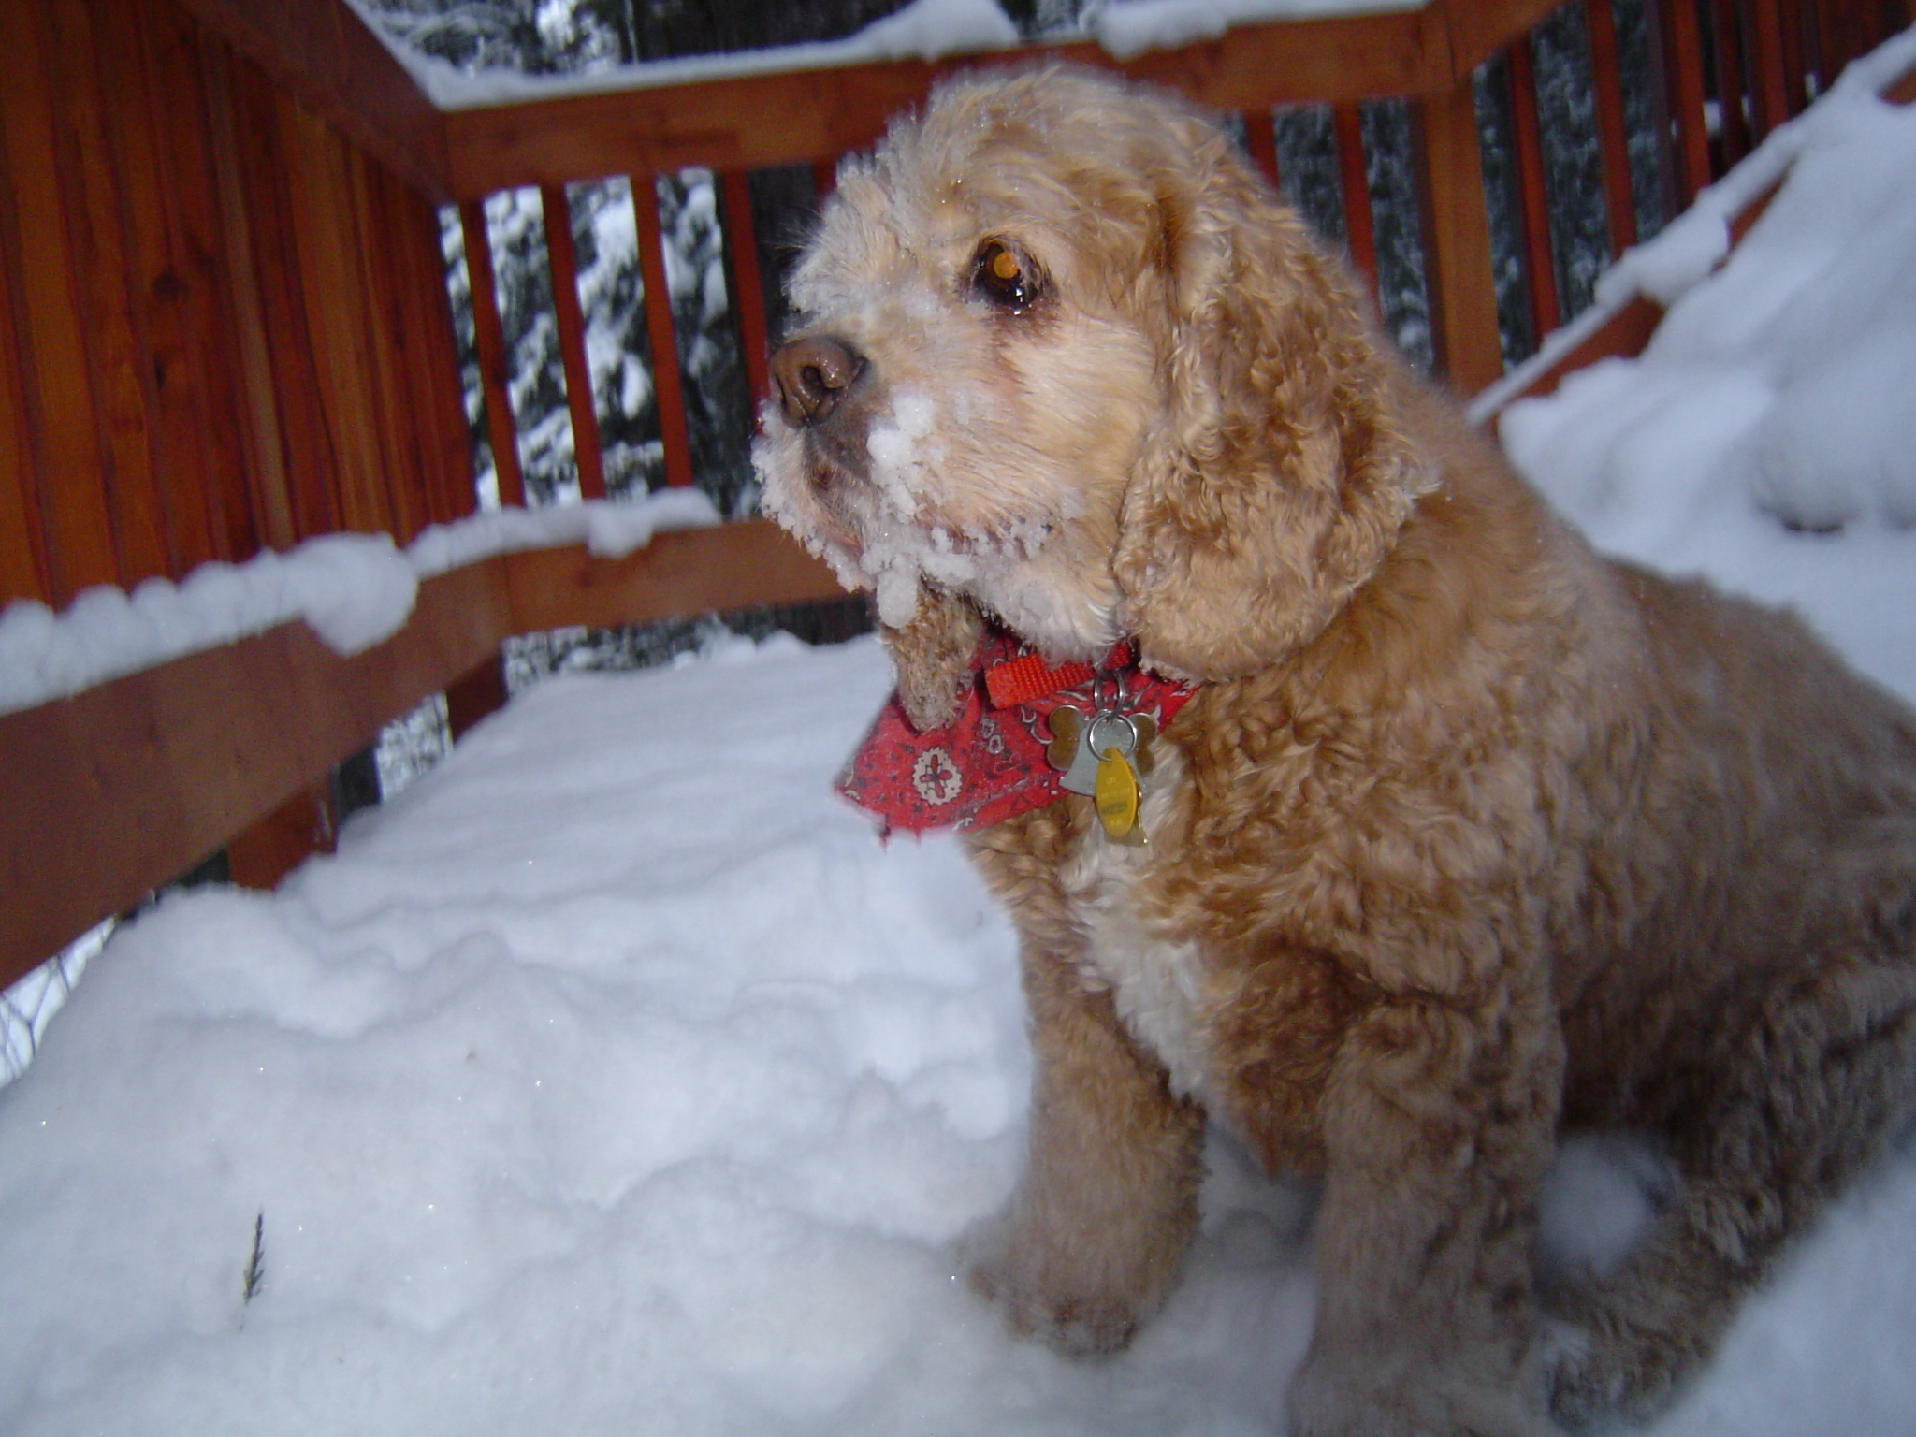

Slide 45
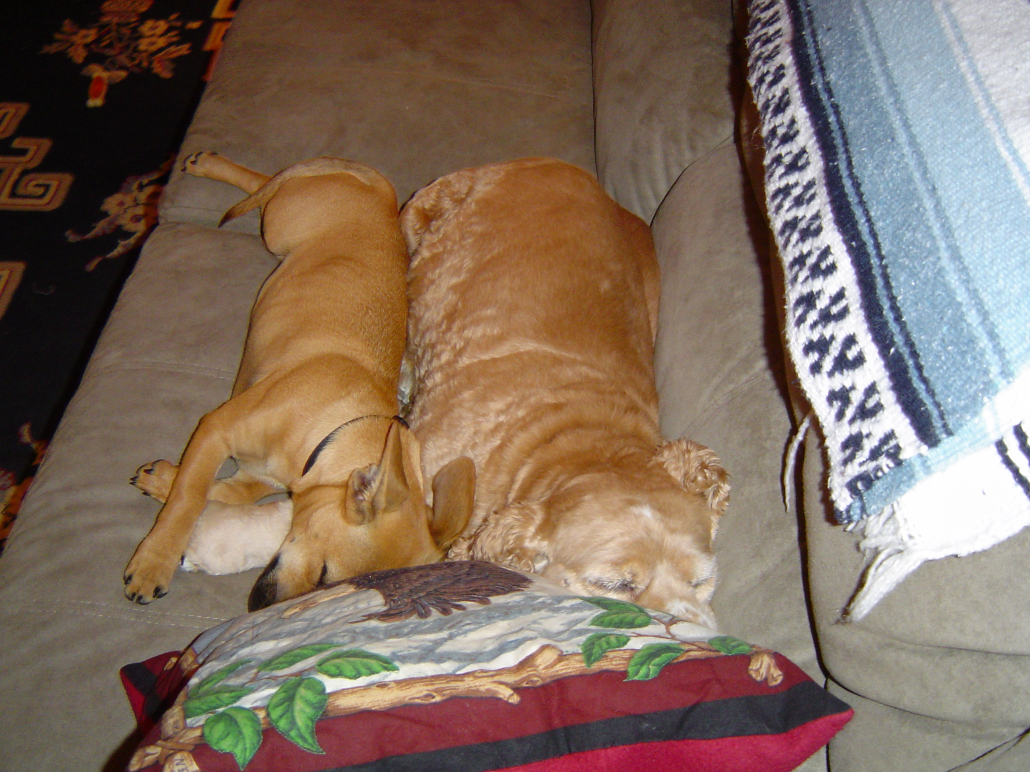

Slide 46
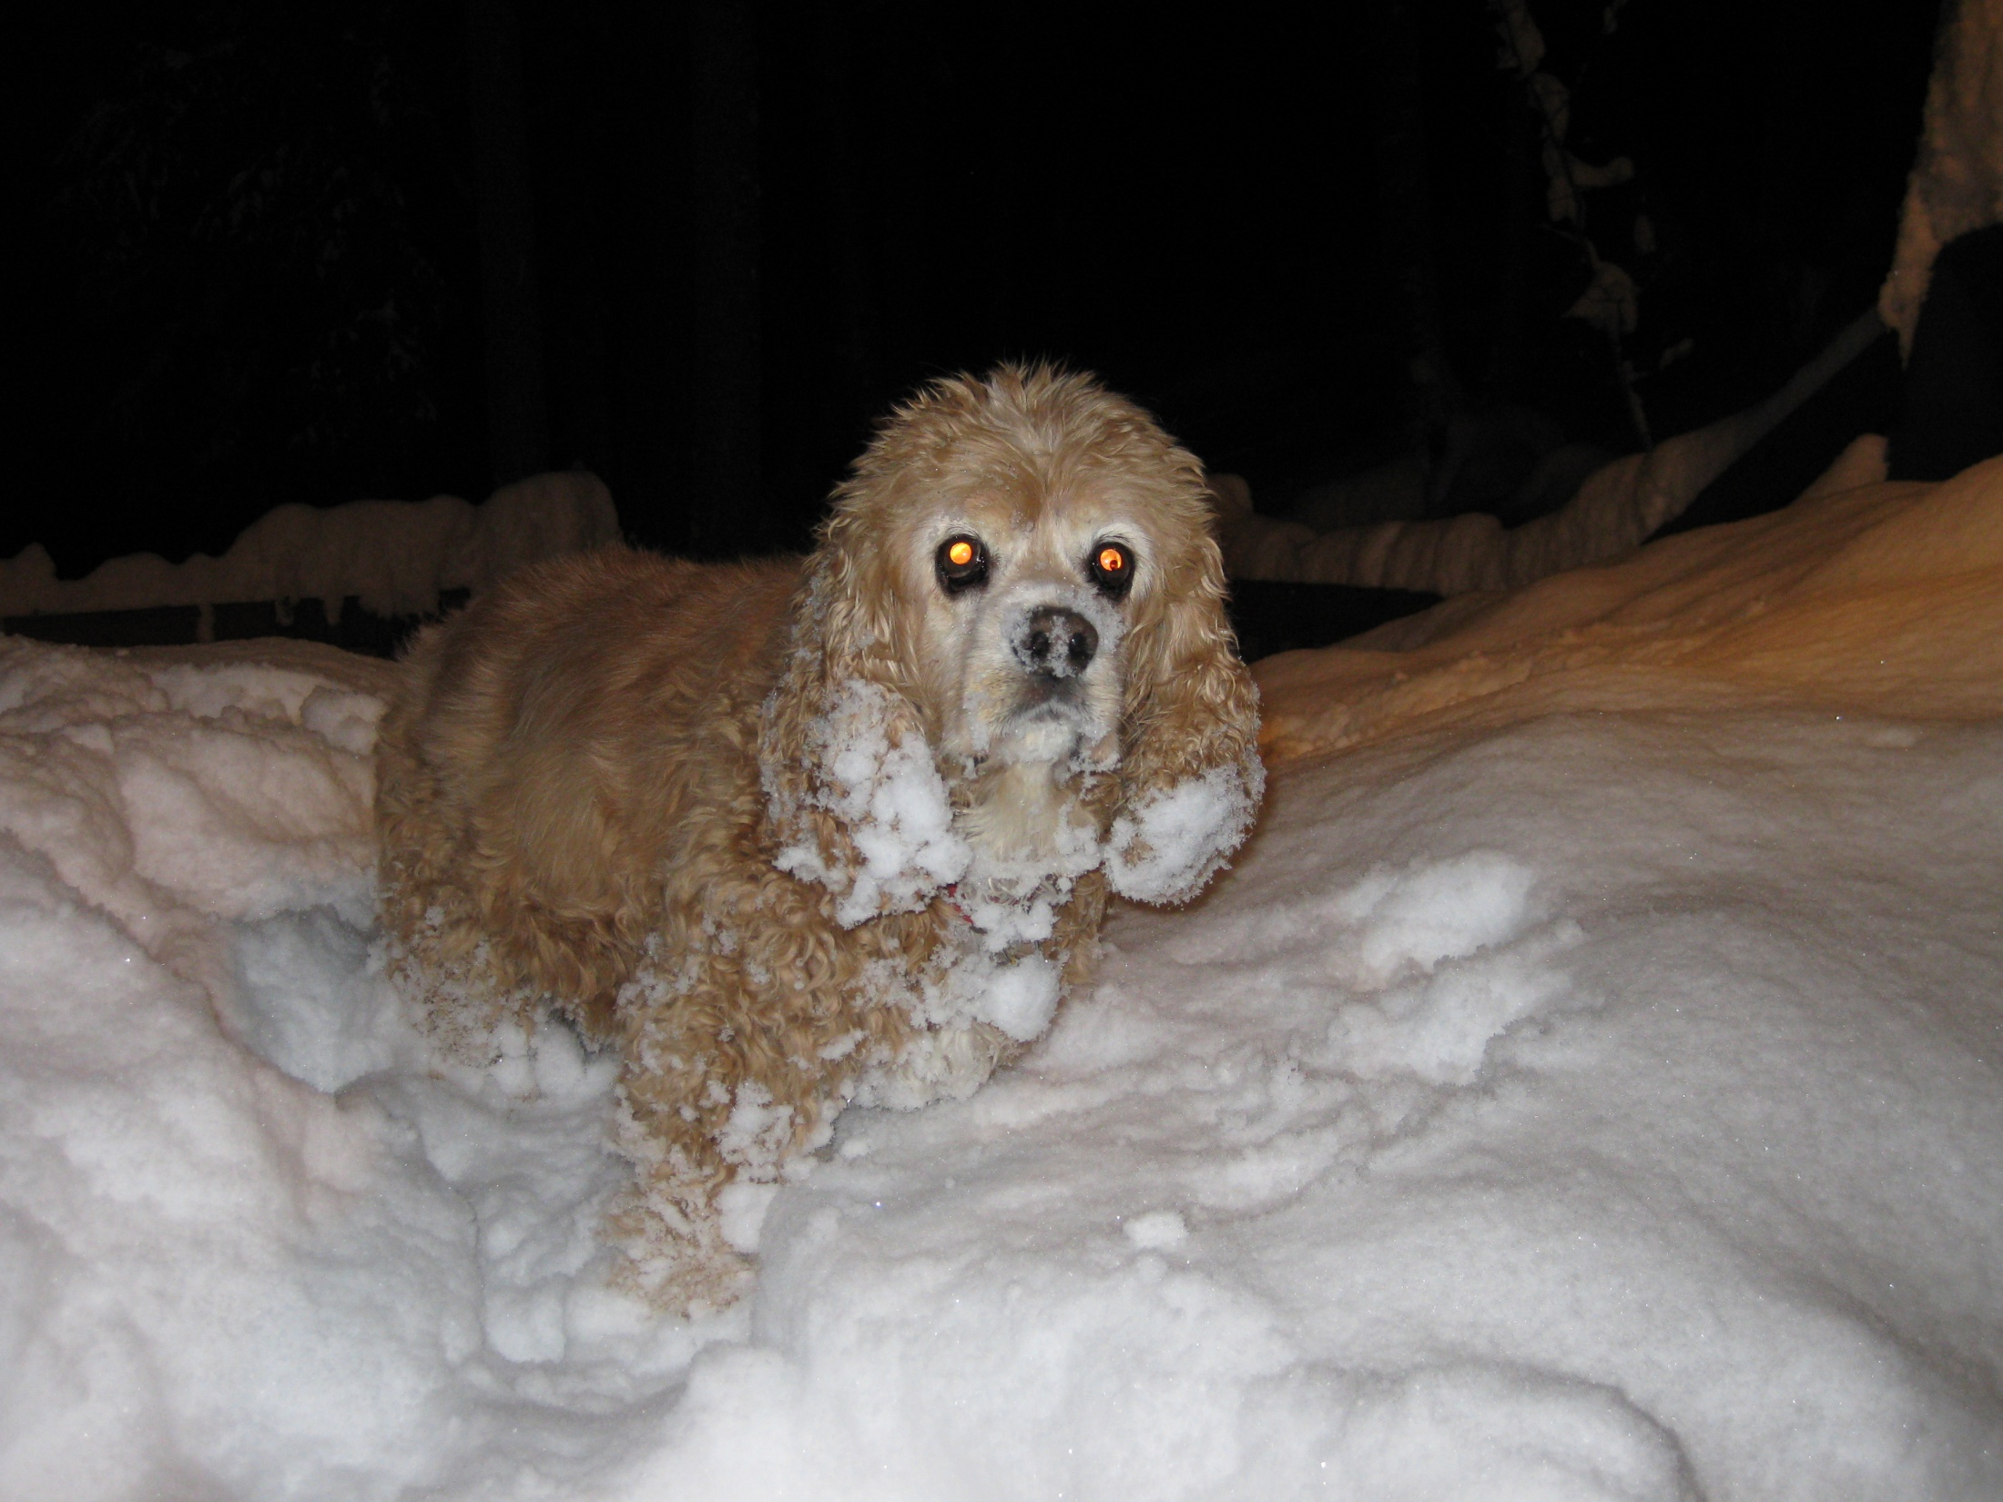
Grammy Scoober – Winter 2009

Slide 47
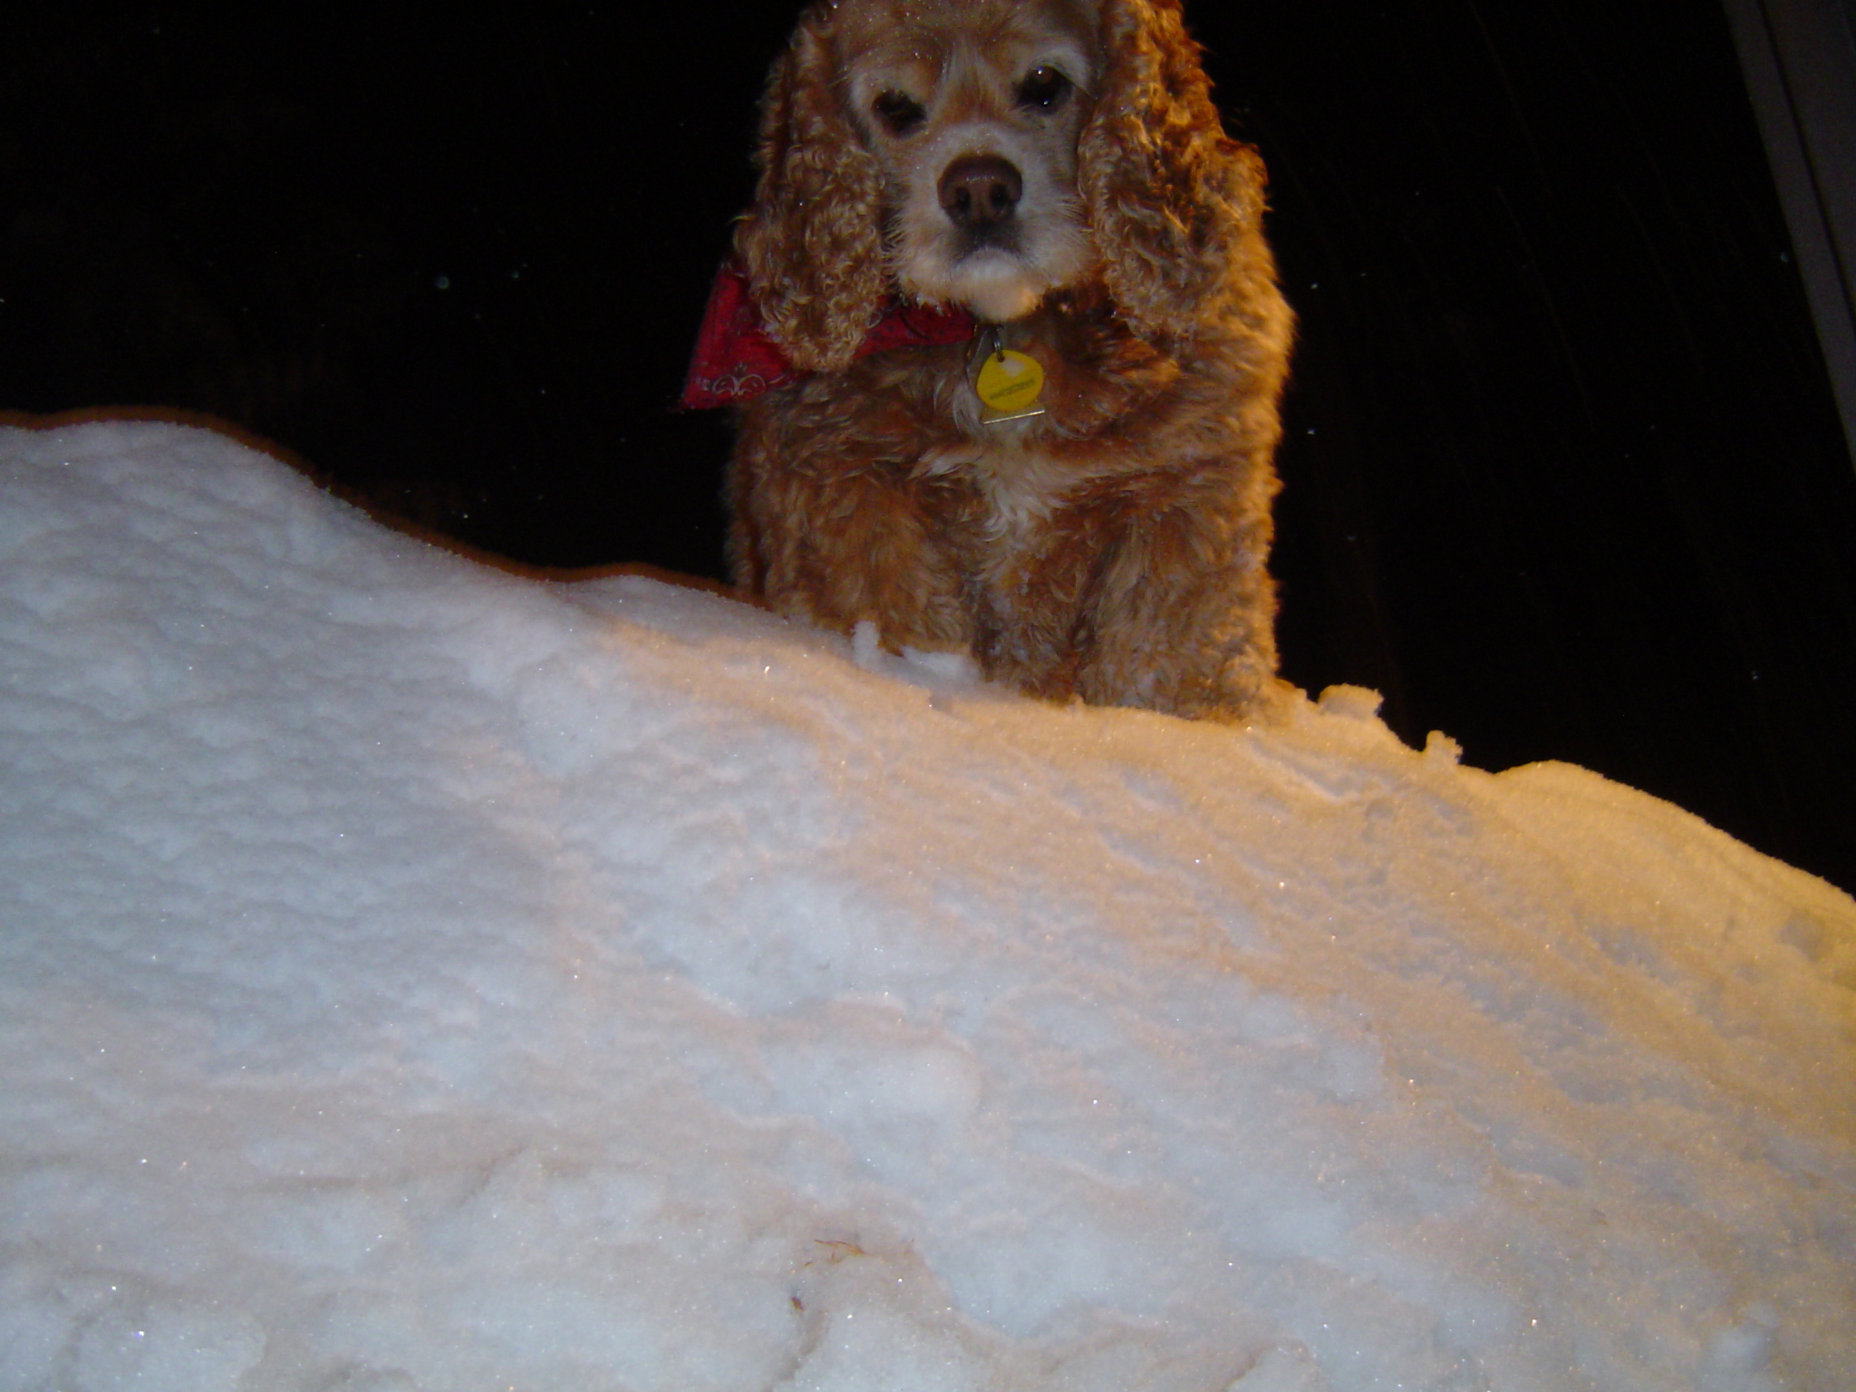
Queen of the Snowpack

Slide 48
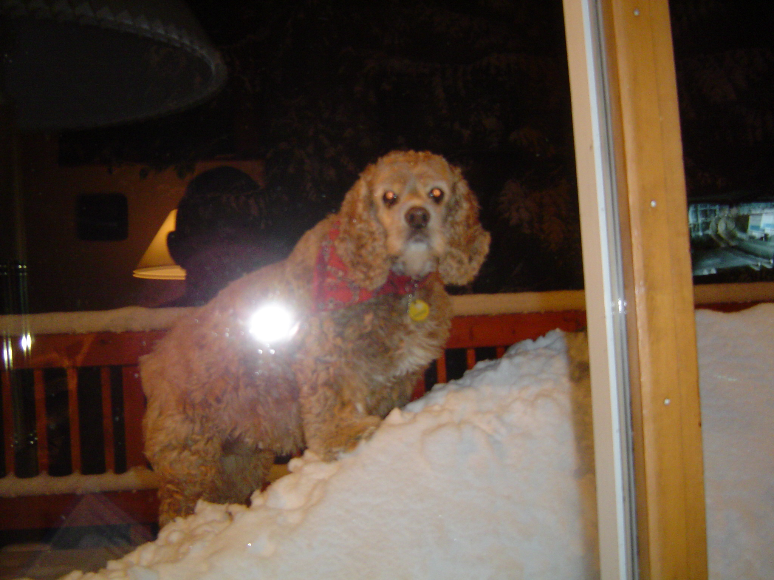
Queen of the Snowpack II

Slide 49
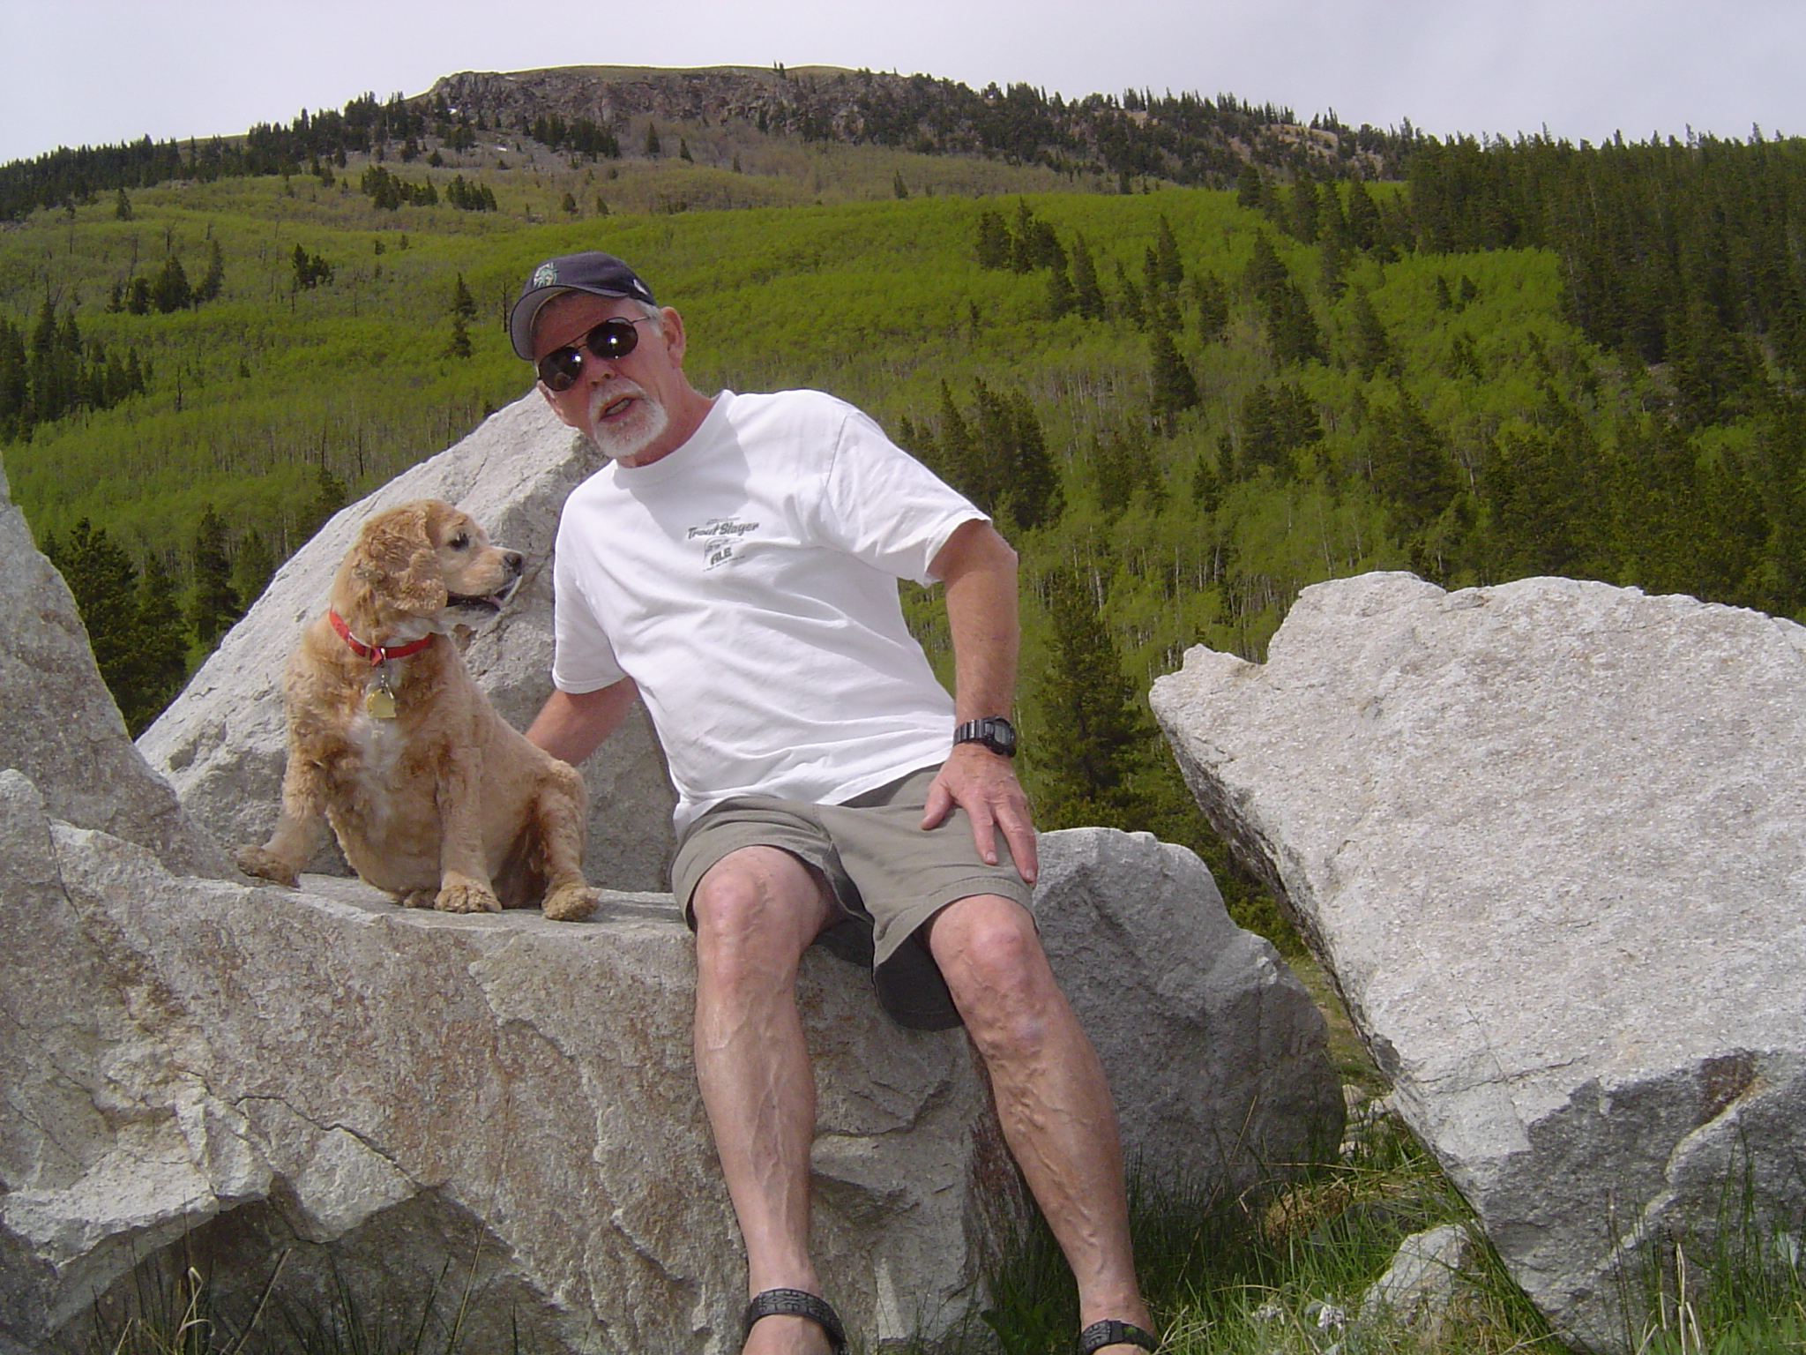
“I’m with you to the end of the earth!”

Slide 50
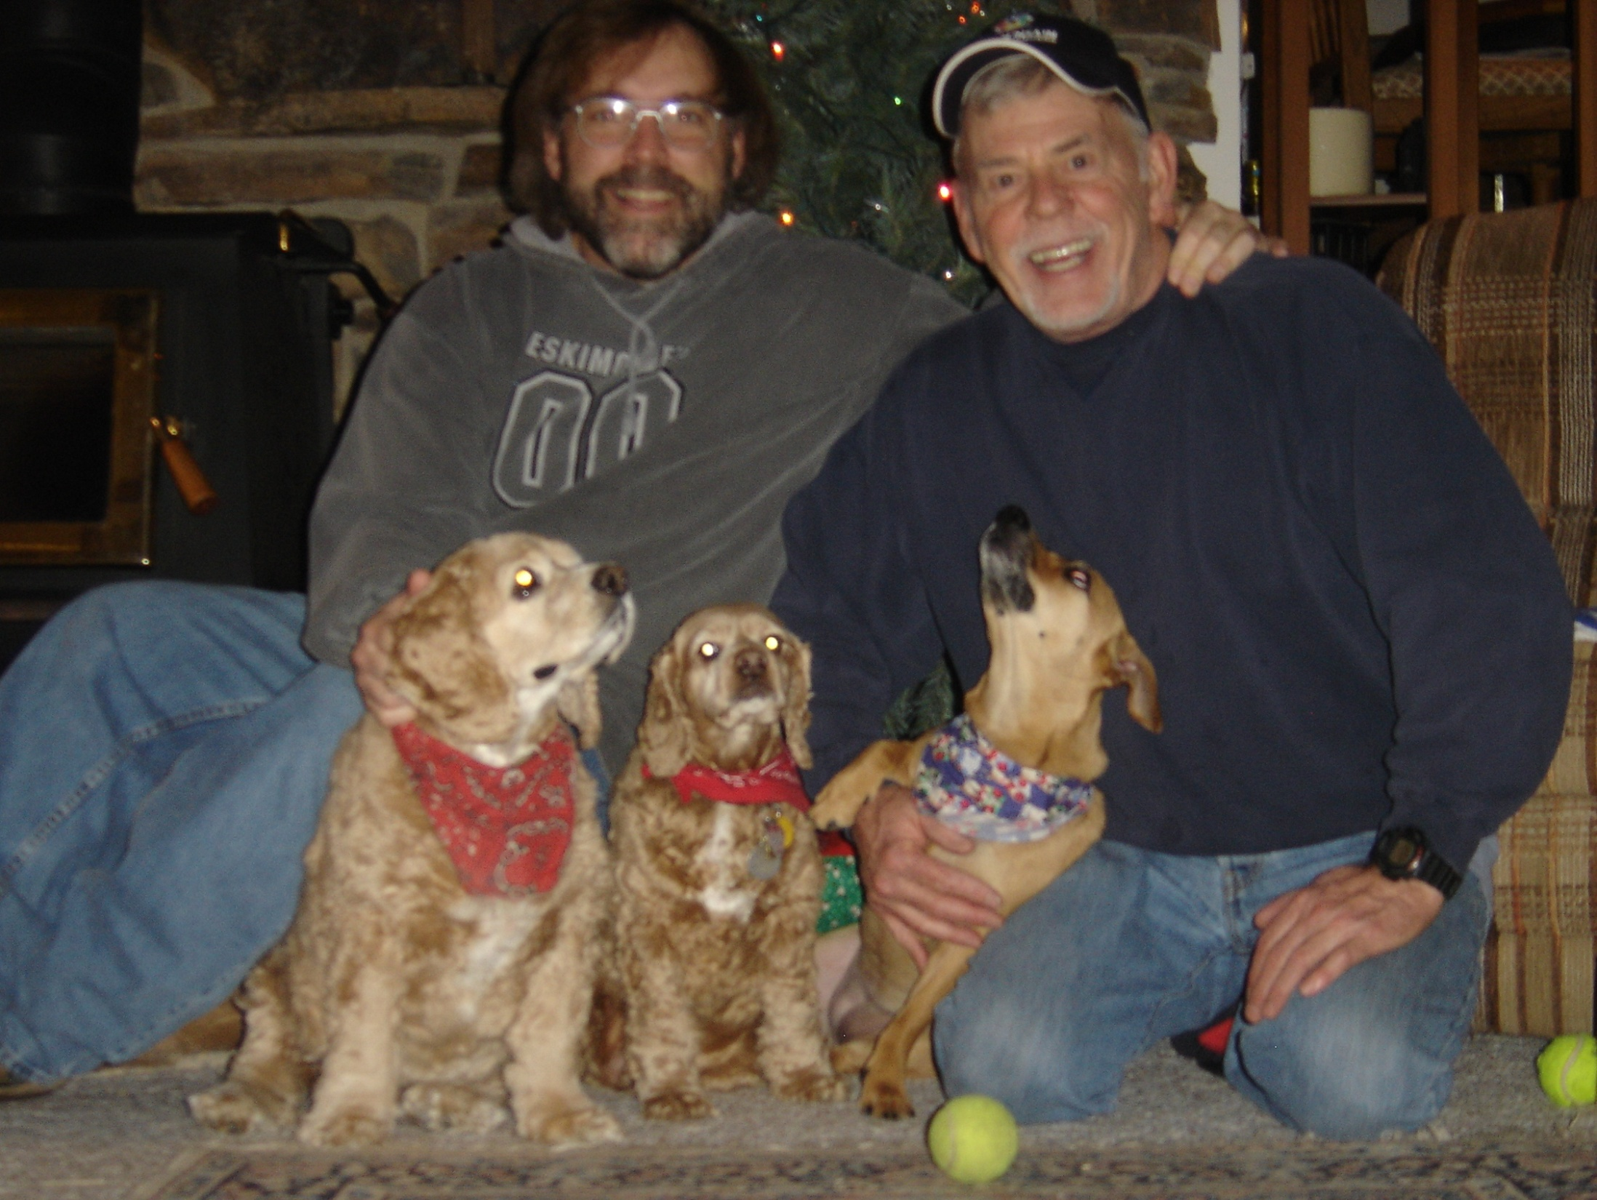
The Murphy-Foster Pack – Christmas 2006

Slide 51

“The snow makes me feel better”

Slide 52


Slide 53

“I don’t know where…but I’m going!”

Slide 54

“Or maybe I’ll just rest right here”

Slide 55


Slide 56

Scoober’s Ptarmigan Village

Slide 57

One of Scoober’s favorite streams

Slide 58

Daddy and his Big Mountain Girl

Slide 59

State of love and trust

Slide 60


Slide 61

Scoober’s Final Resting Spot

Slide 62

Scoober - In Loving Memory

Slide 63


Slide 64
Remembering Scoober
Pics and Video by Foster, Murphy, friends and family
Music by Daughtry
Beauty, soul and spirit brought to you by our eternal Creator - Who made the sweet being we knew as Scoober.
May she rest in peace and love and greet us when we pass into our own eternal rest.
God bless you all! From our pack to yours –
The Murphy & Foster Pack – August 2009

